Slide 1
Power Platform
The Game Changer
Hiram Fleitas
Download: github.com/hfleitas/pbifest2019

Slide 2
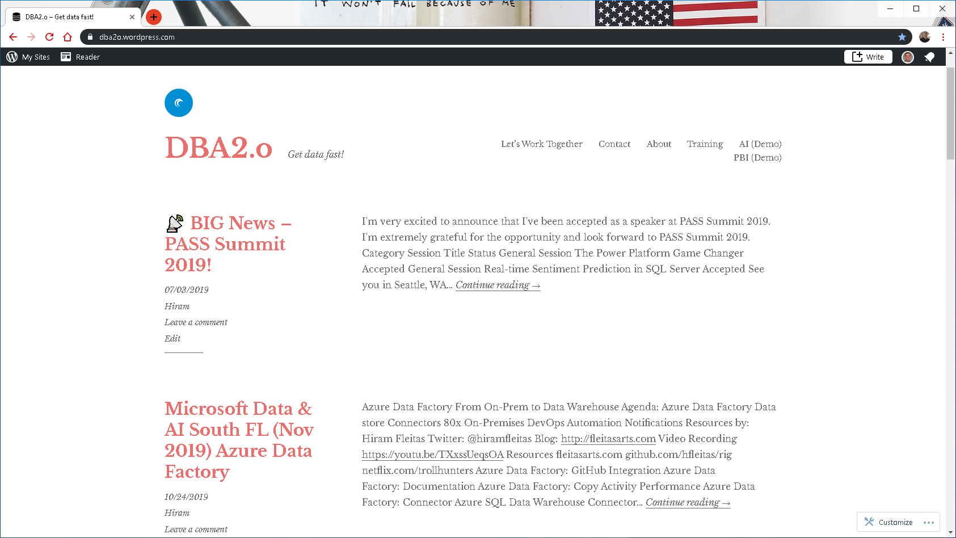

Slide 3


Link to Eval:
bit.ly/pbifest19
Your participation is very important.

Slide 4












Hiram Fleitas
Owner
Fleitas Arts
Bio
Father
Developer since 1995
SQL Server since 1999
Fleitas Arts, LLC since 2008
USCG Auxiliary Flotilla Staff Officer
@hiramfleitas
/hfleitas
hiram@fleitasarts.com
hiramfleitas
fleitasarts.com

Slide 5
Agenda
Azure Data Studio Notebook
PowerApps
Microsoft Flow
Data Gateway
Siri
Publish & Share Security

Slide 6
Azure Data Studio Notebook
one

Slide 7
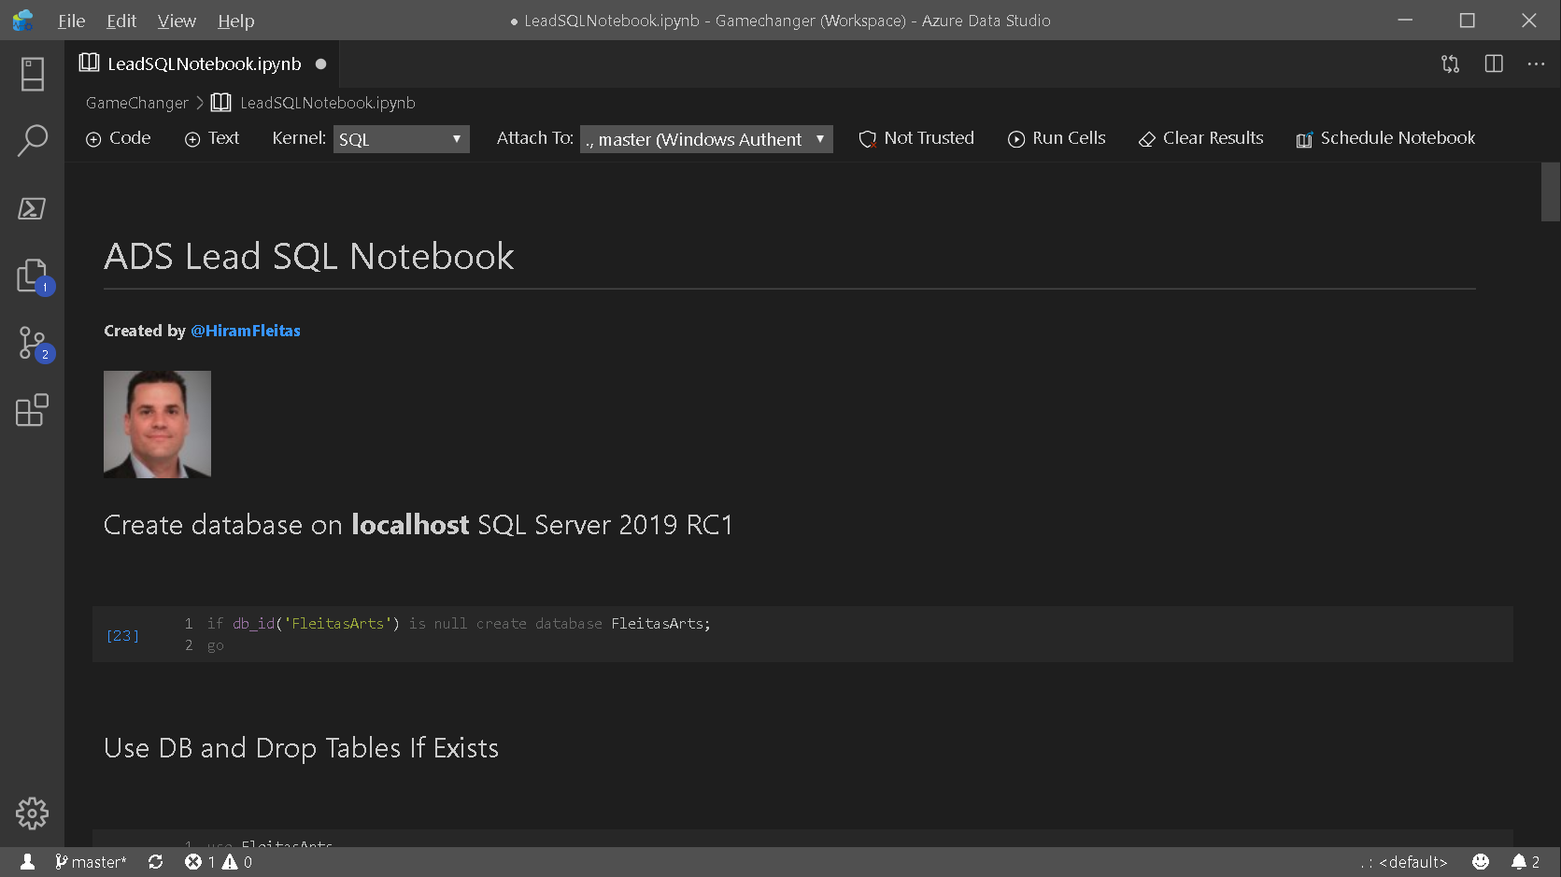

Slide 8
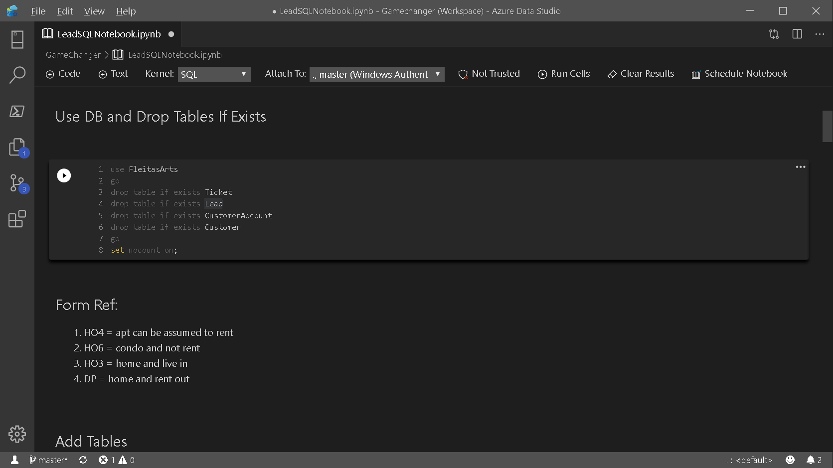

Slide 9
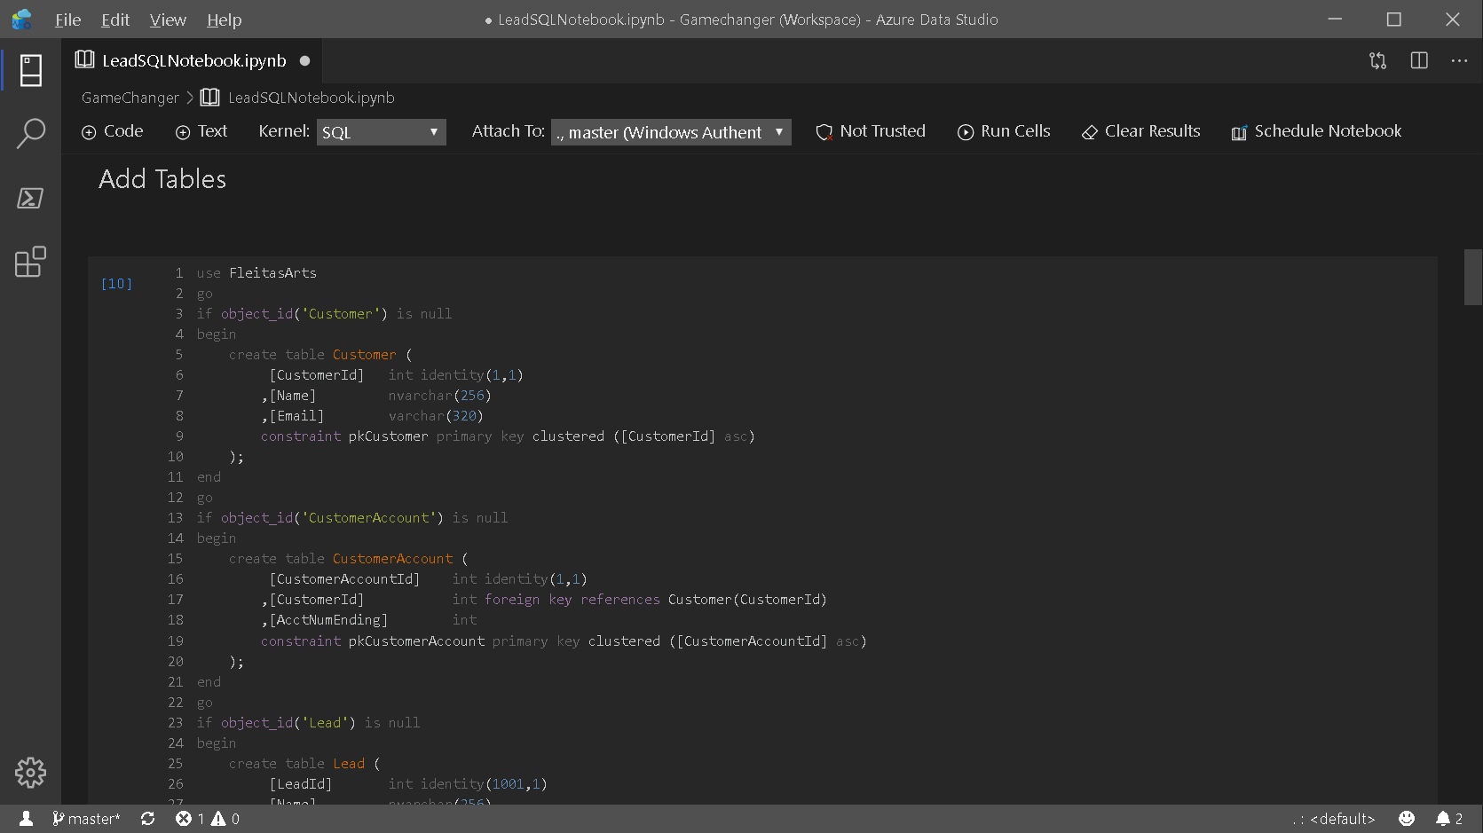

Slide 10
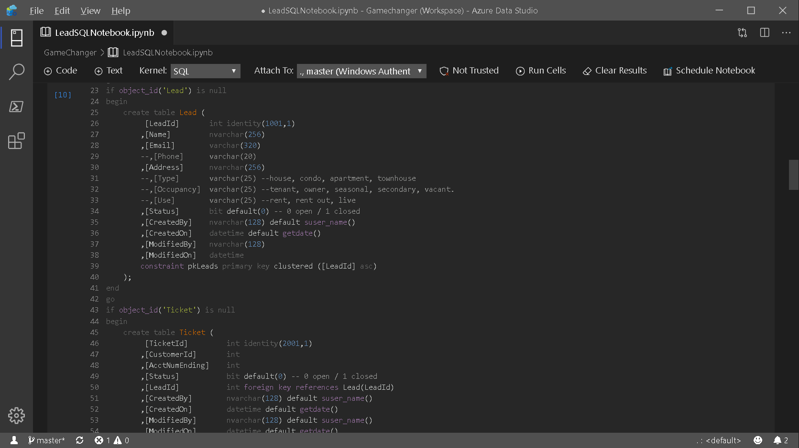

Slide 11
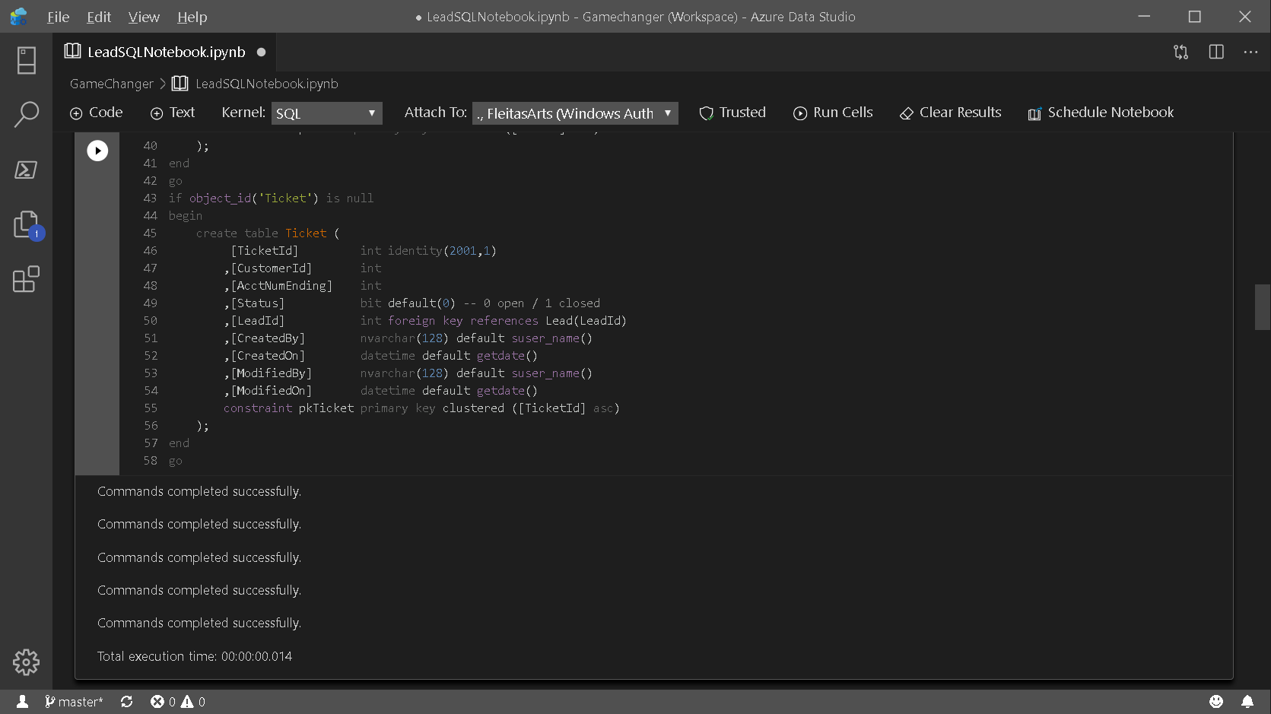

Slide 12
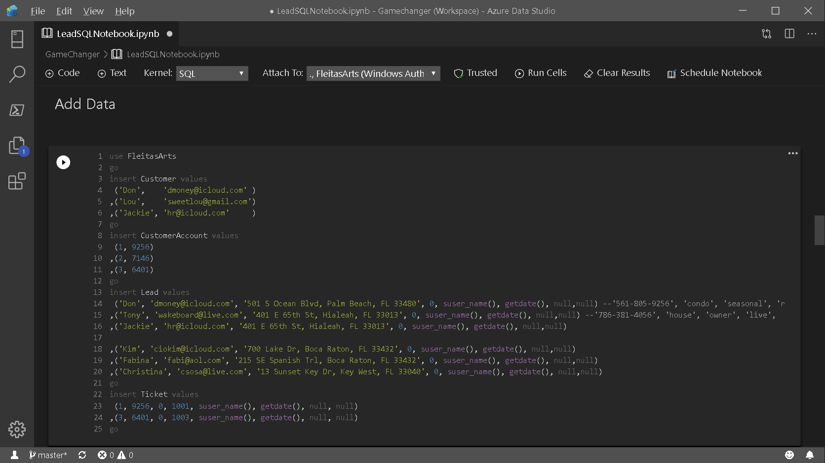

Slide 13
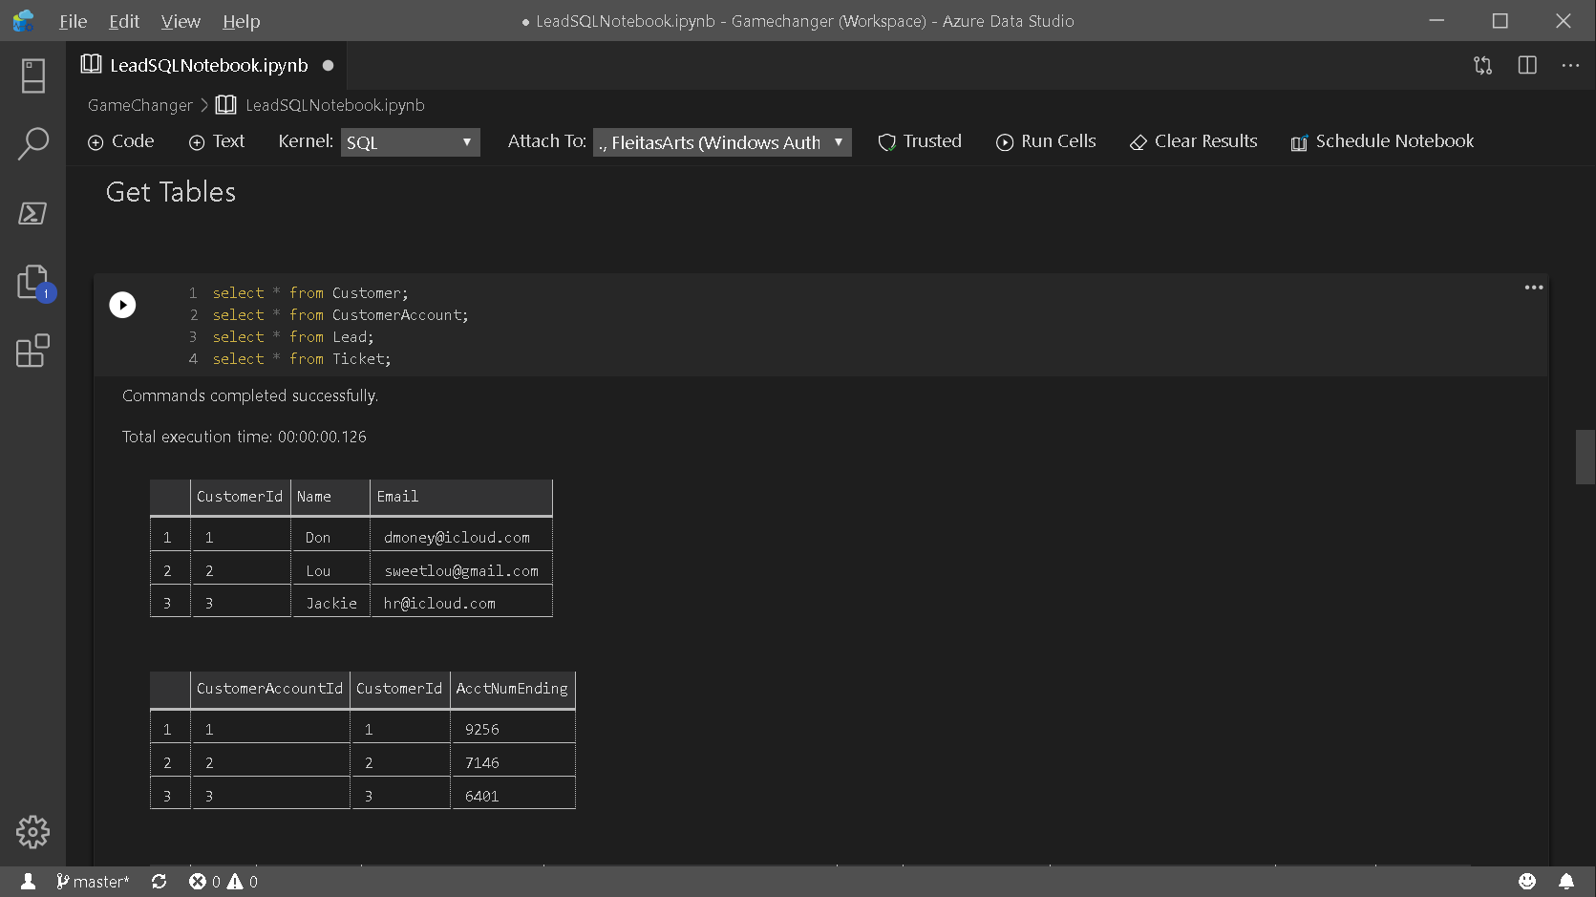

Slide 14
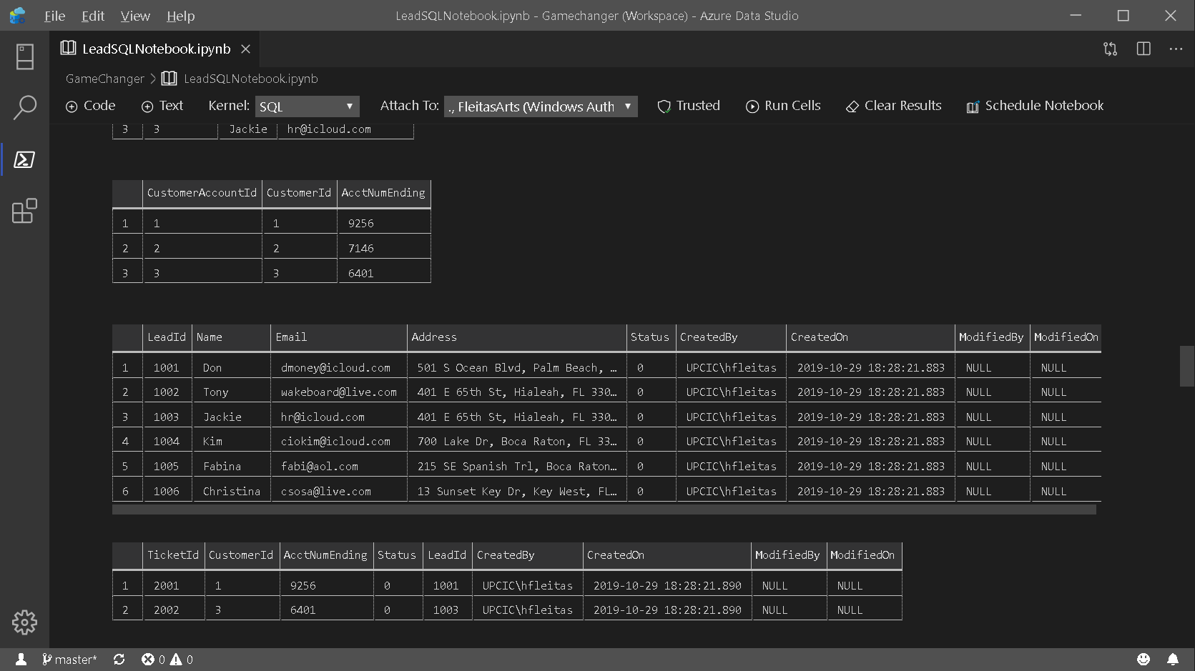

Slide 15
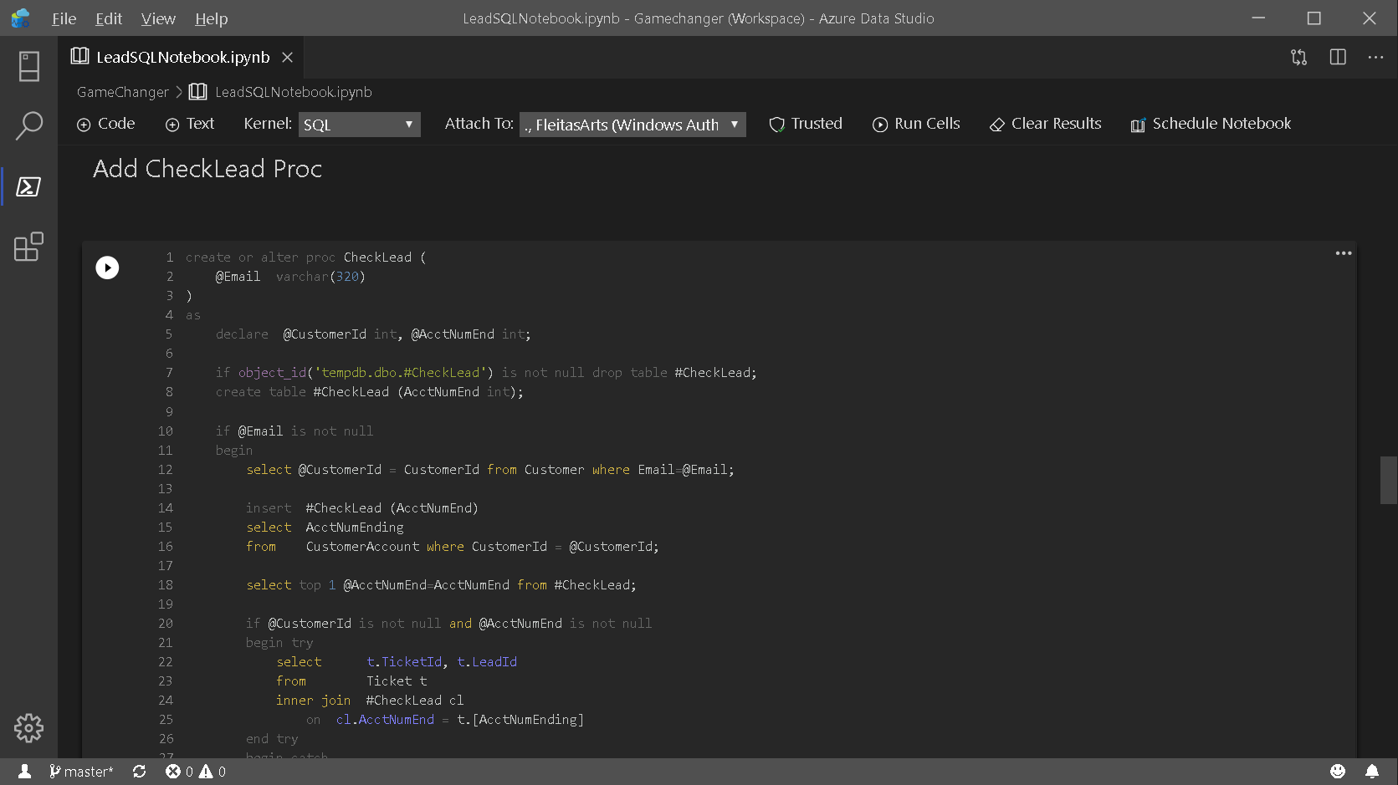

Slide 16
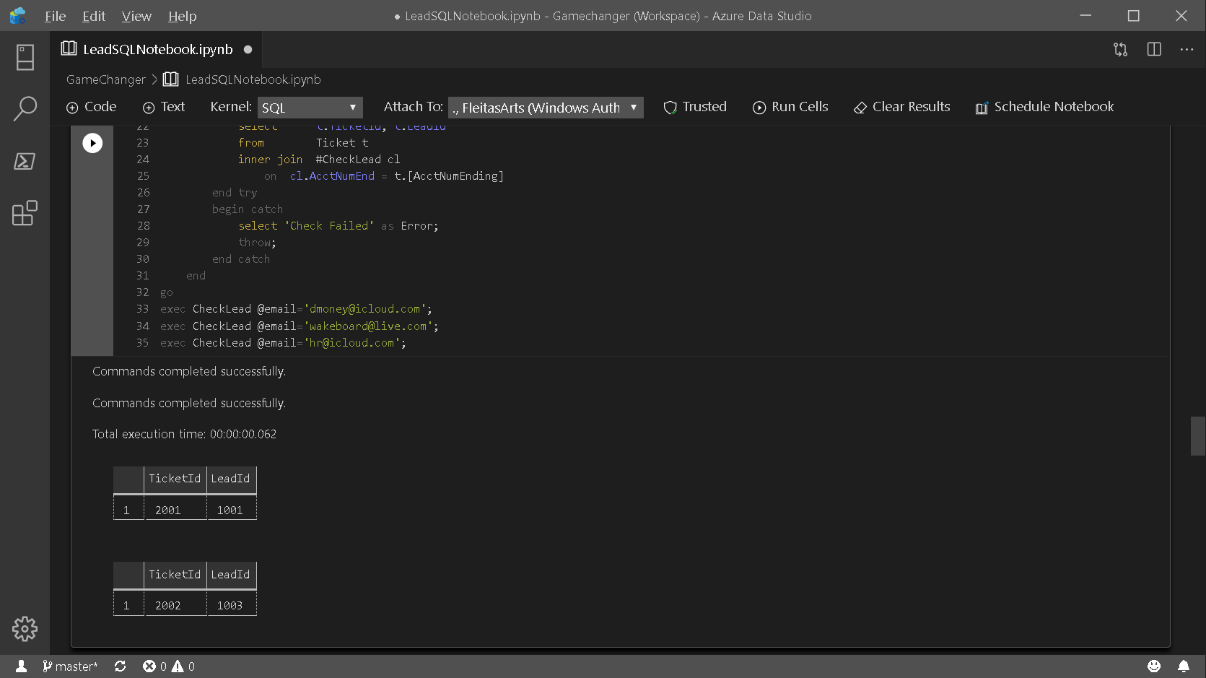

Slide 17
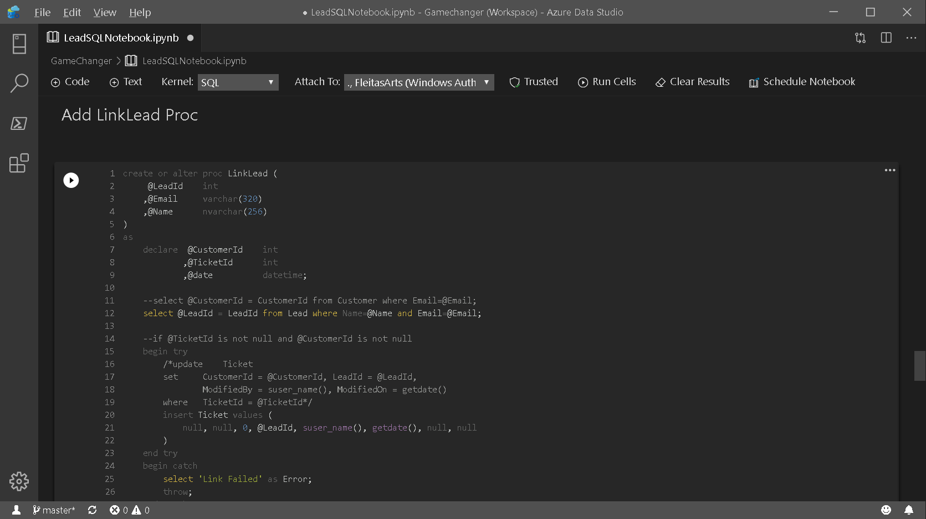

Slide 18
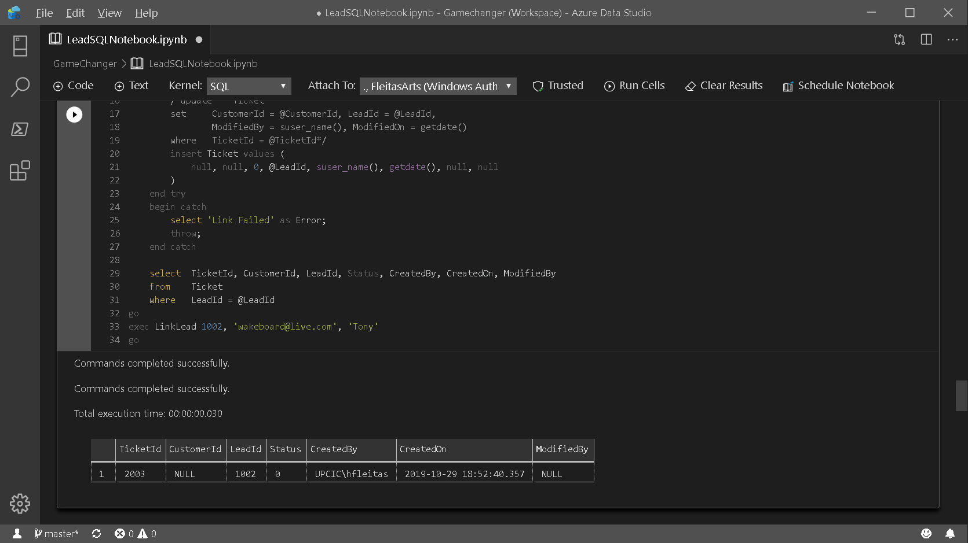

Slide 19
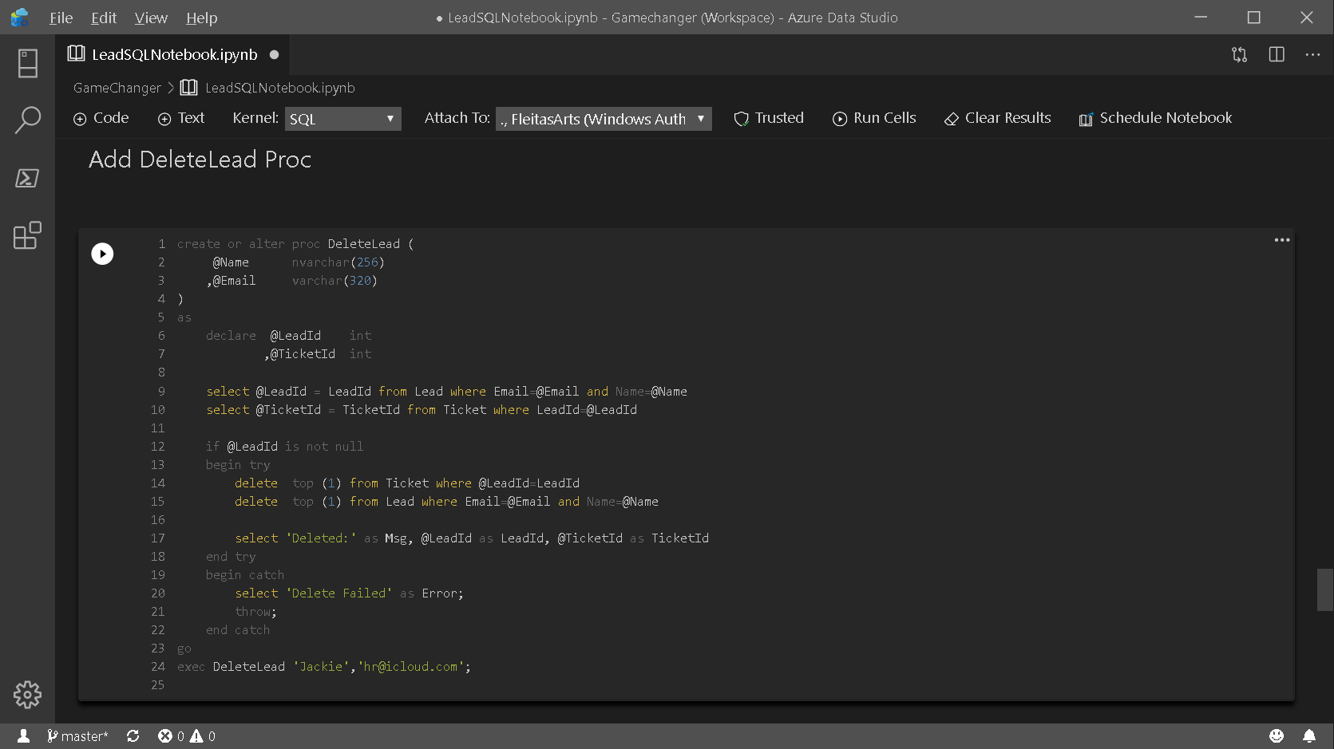

Slide 20
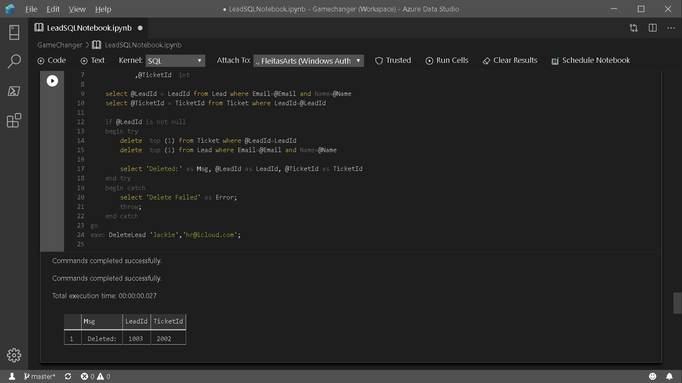

Slide 21
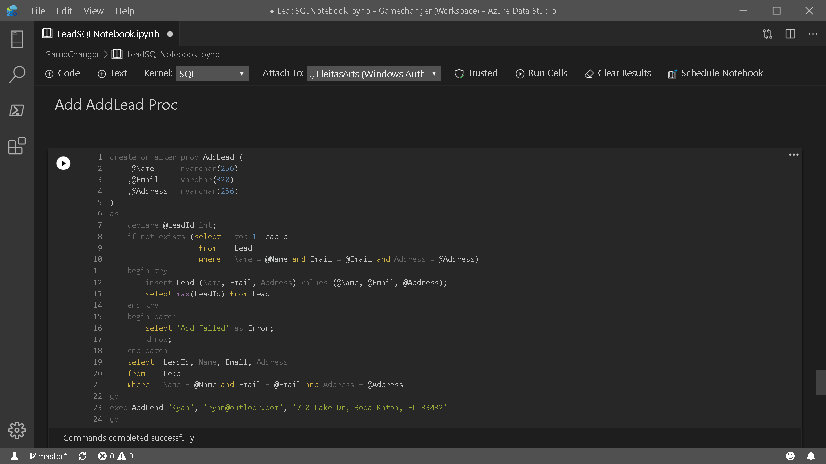

Slide 22
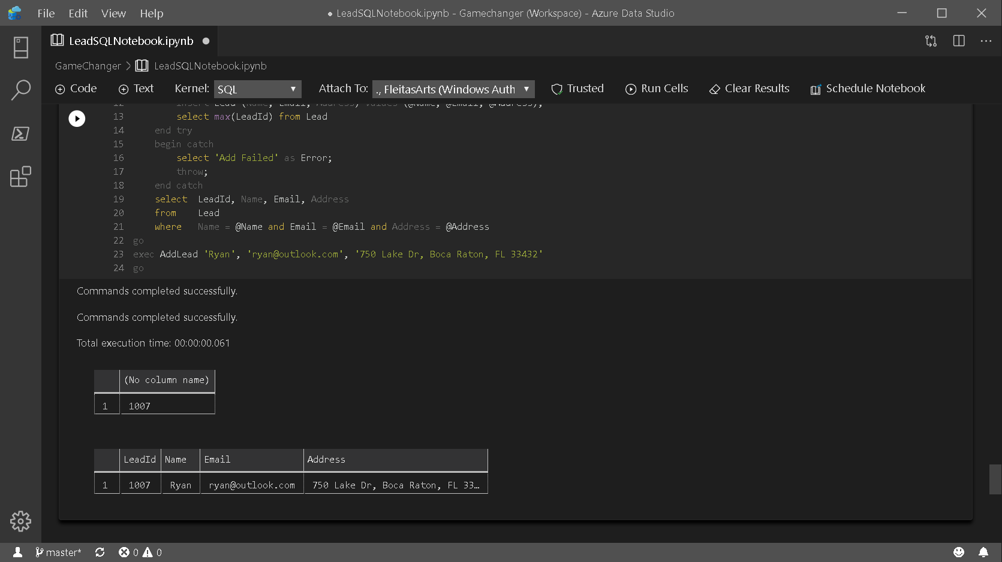

Slide 23
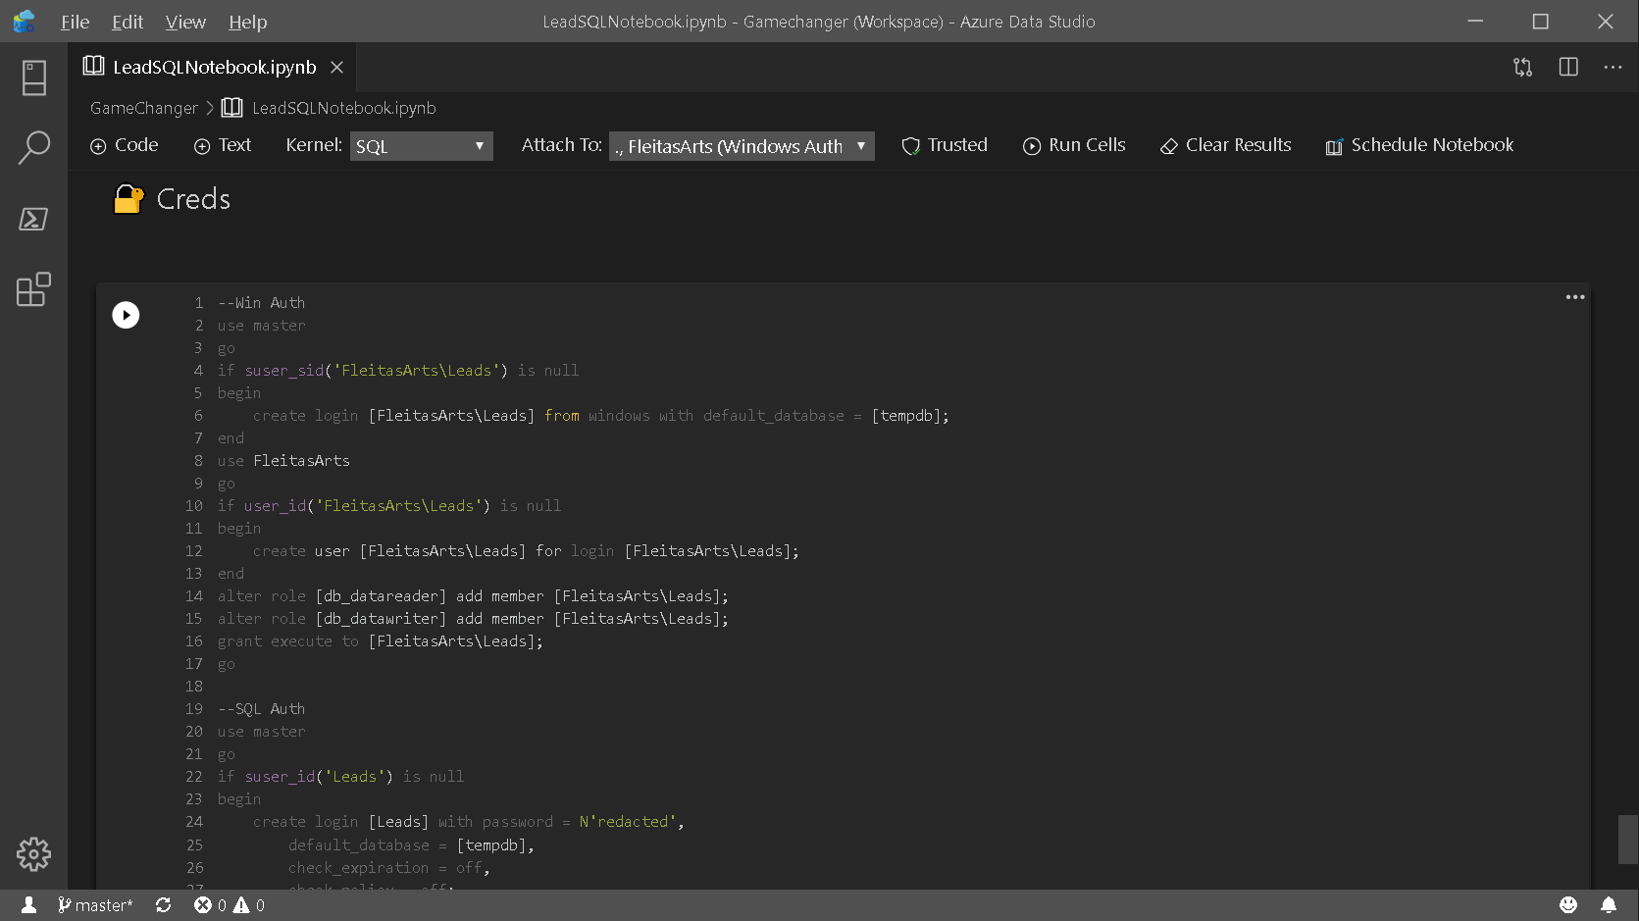

Slide 24
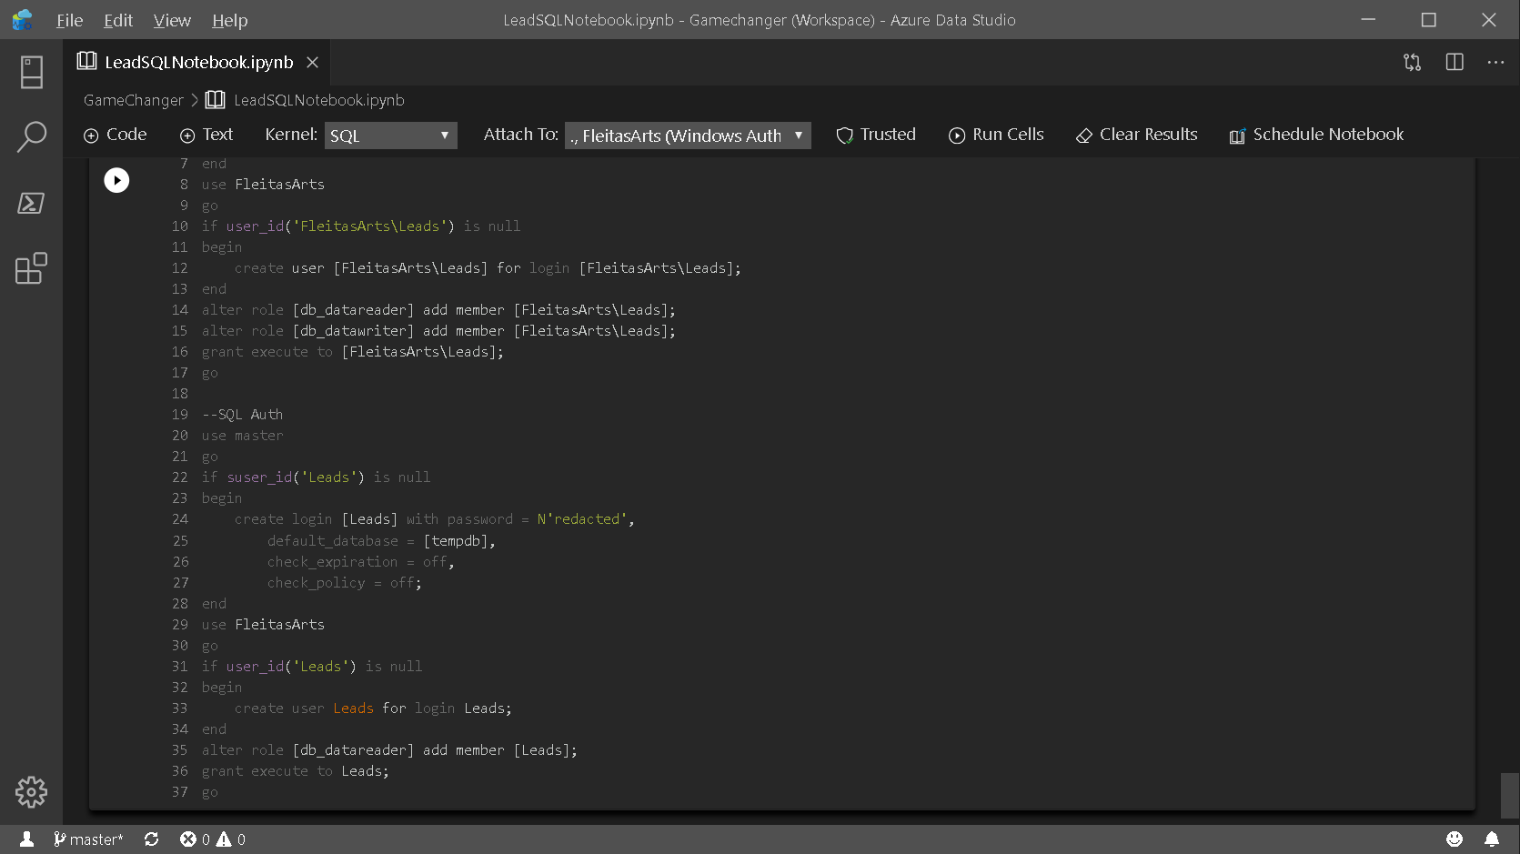

Slide 25
PowerApps
two

Slide 26
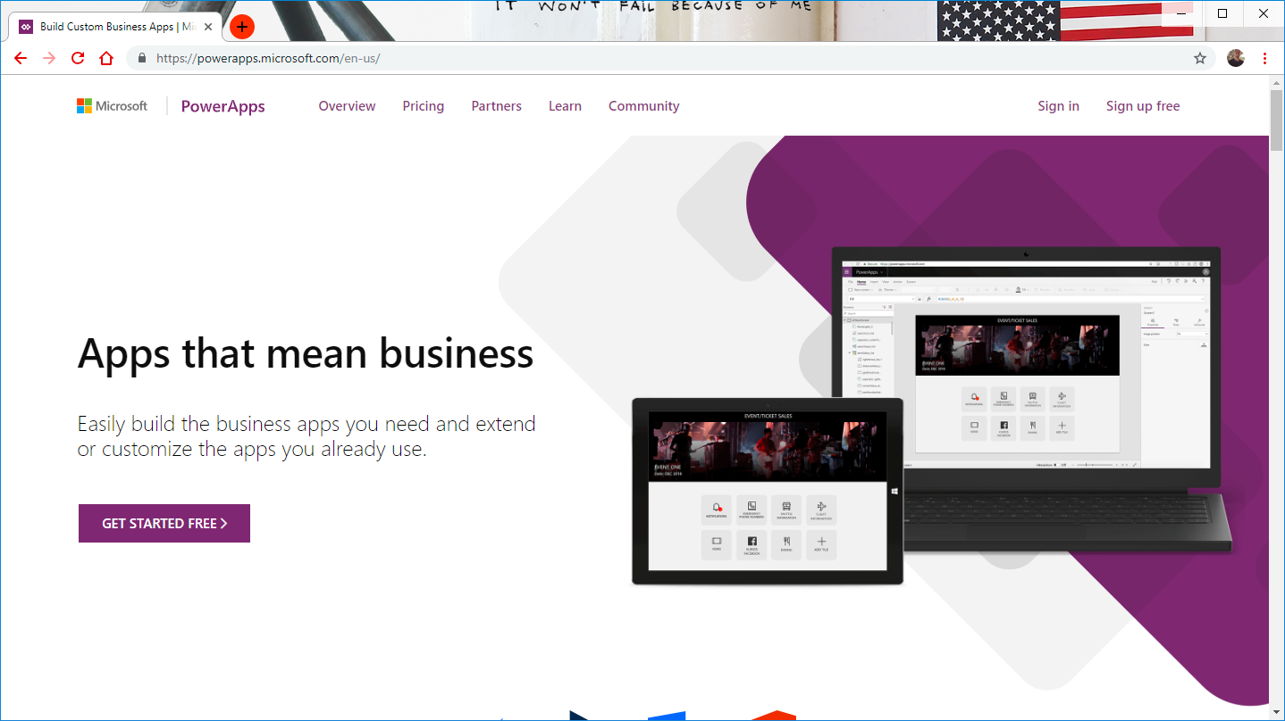

Notes:
Goto: http://powerapps.com, Sign In.

Slide 27
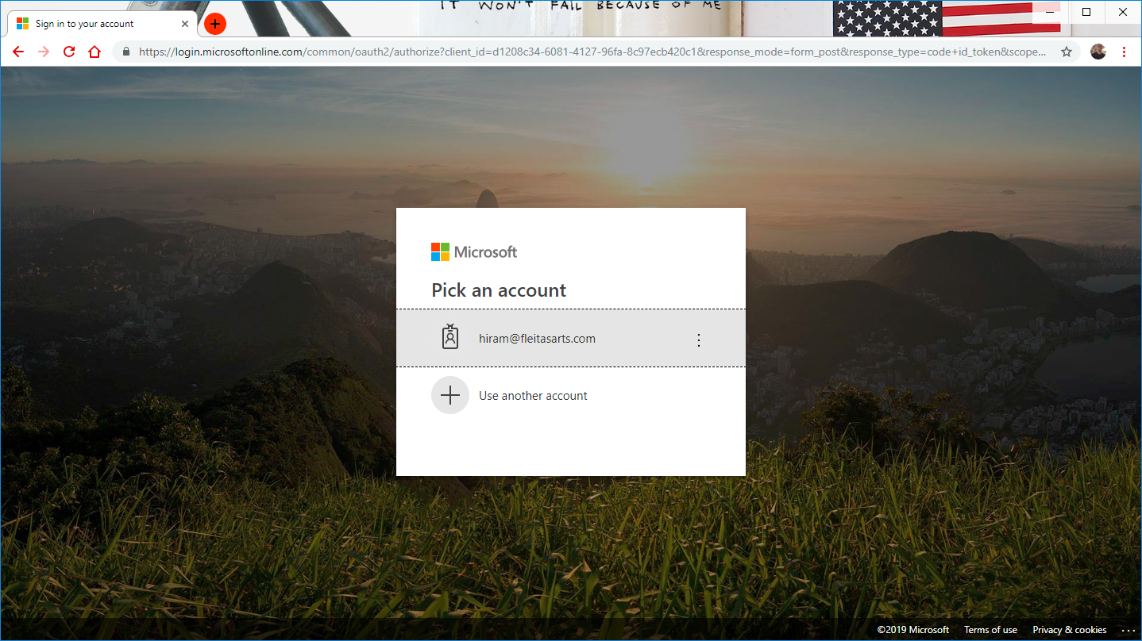
Notes:
Login: http://web.powerapps.com

Slide 28
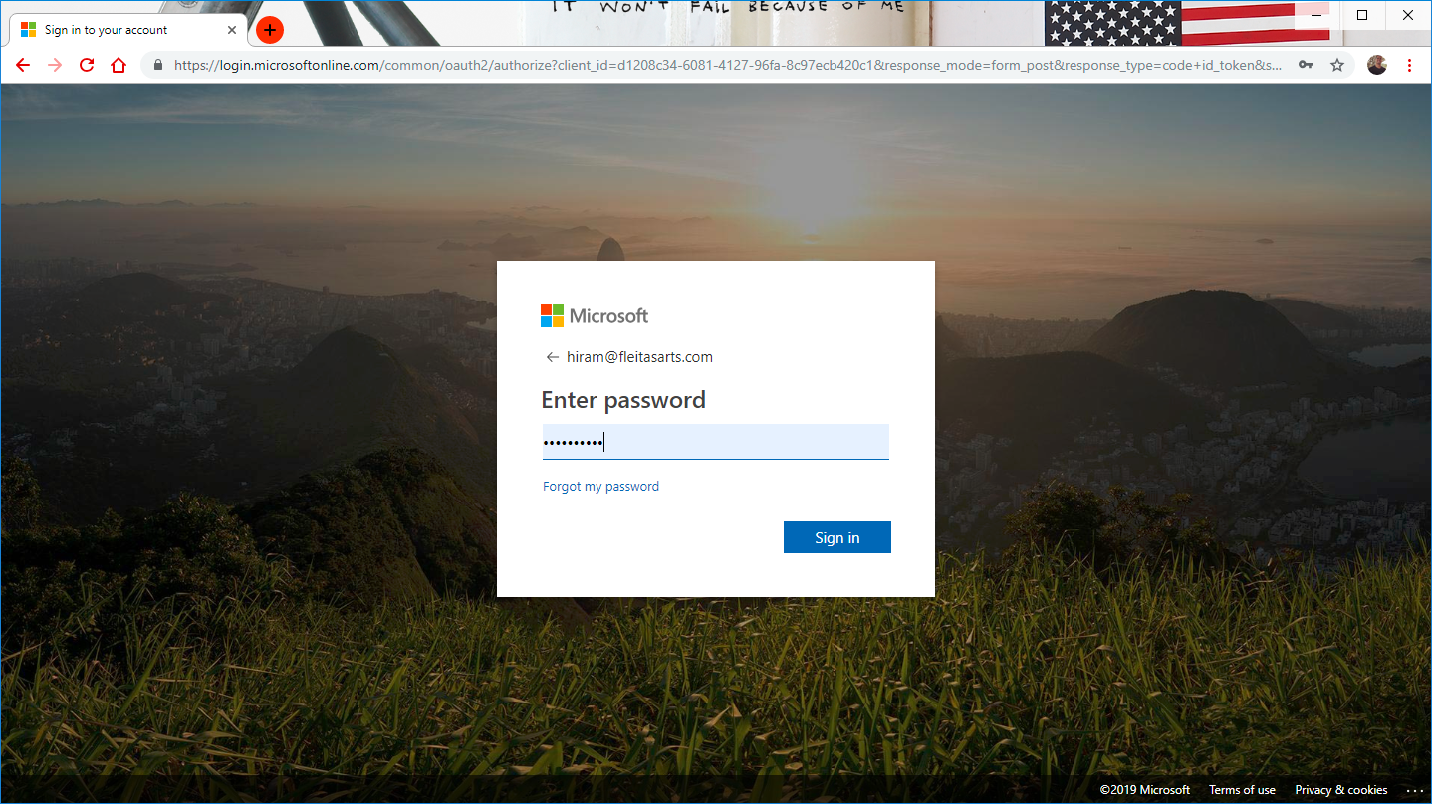
Notes:
Login: http://web.powerapps.com

Slide 29
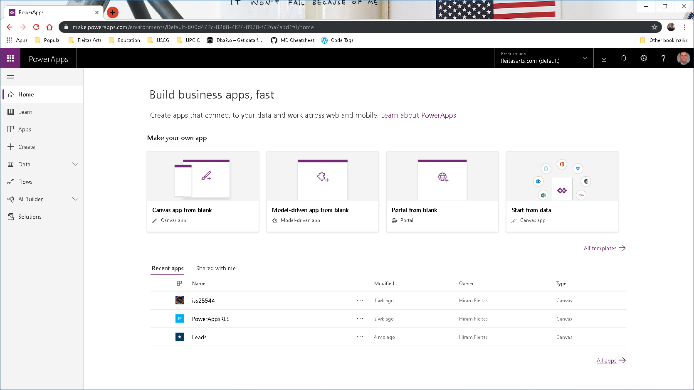

Slide 30
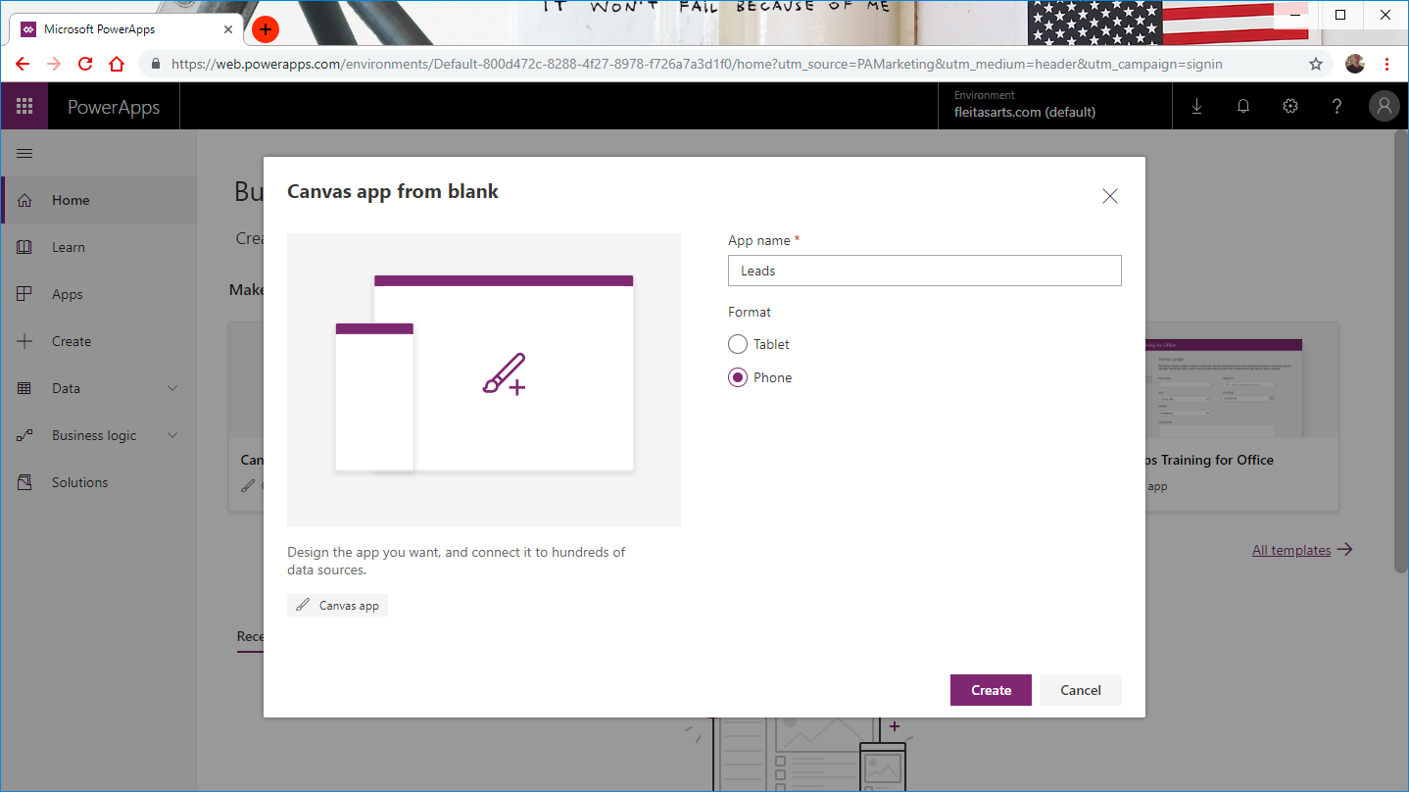

Slide 31
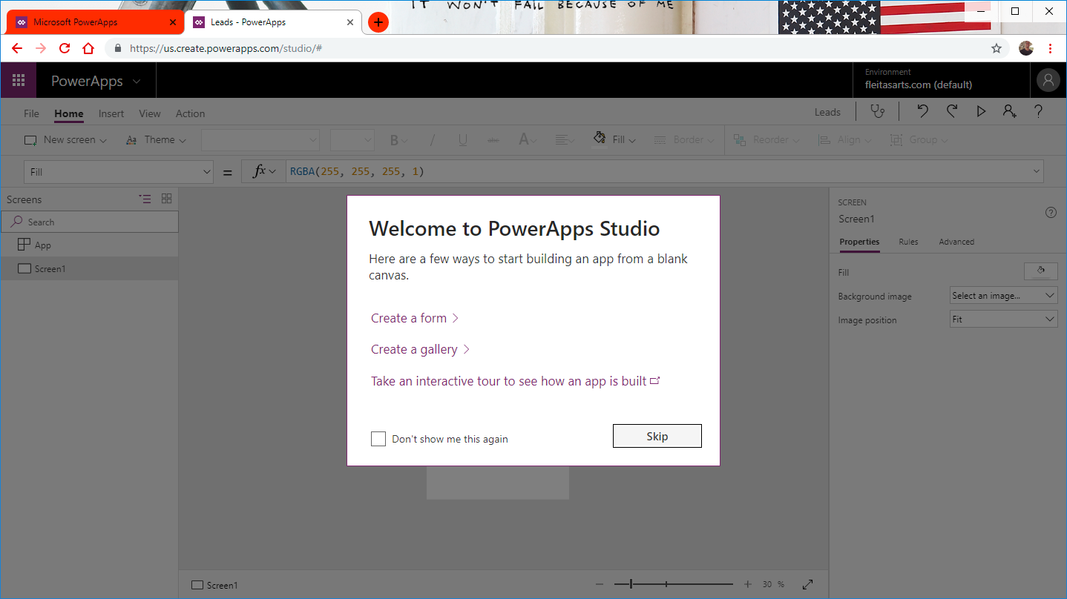

Slide 32
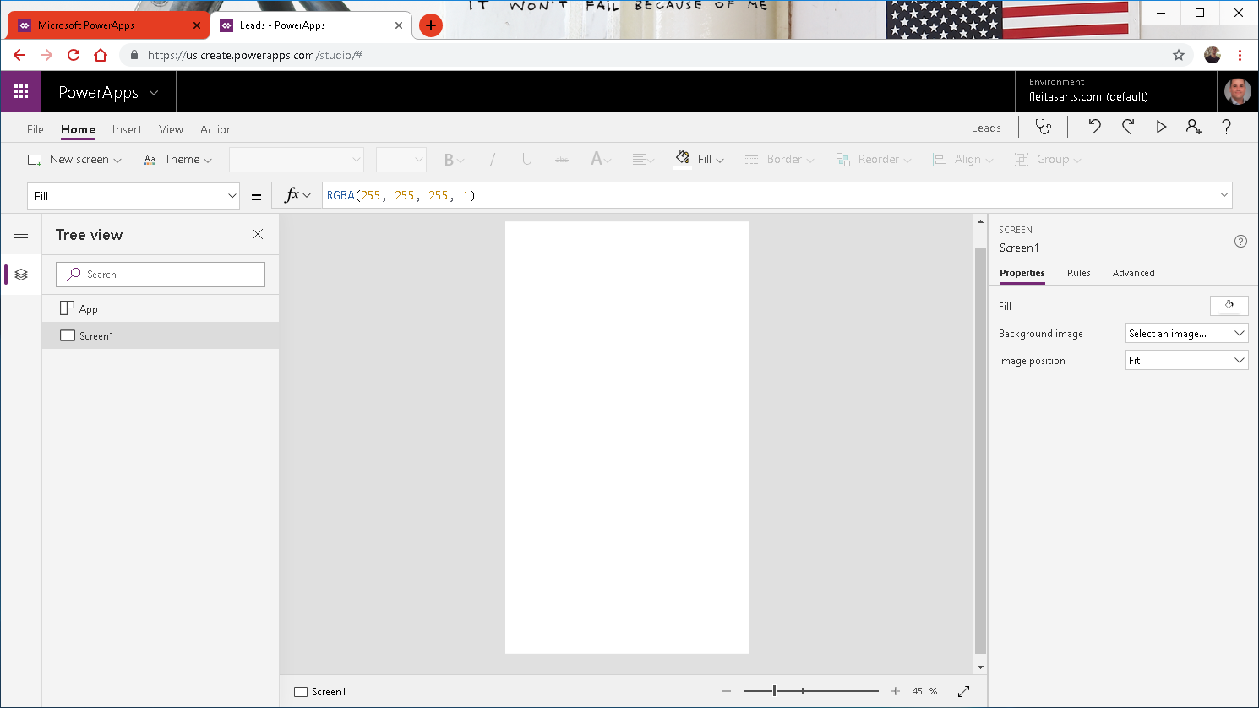

Slide 33
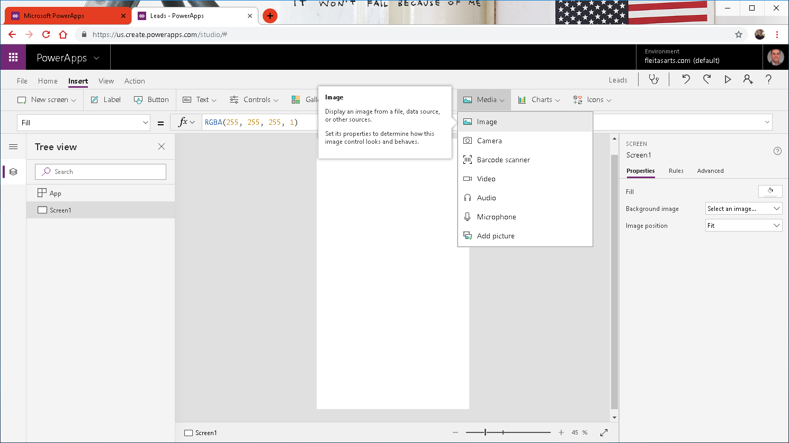

Slide 34
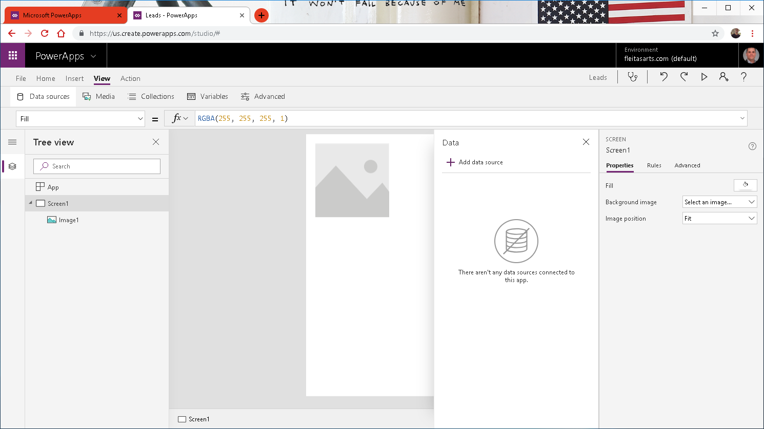

Slide 35
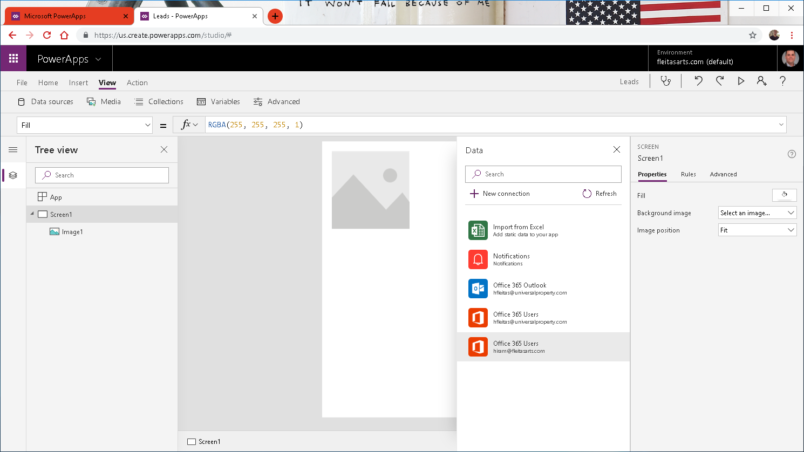

Slide 36
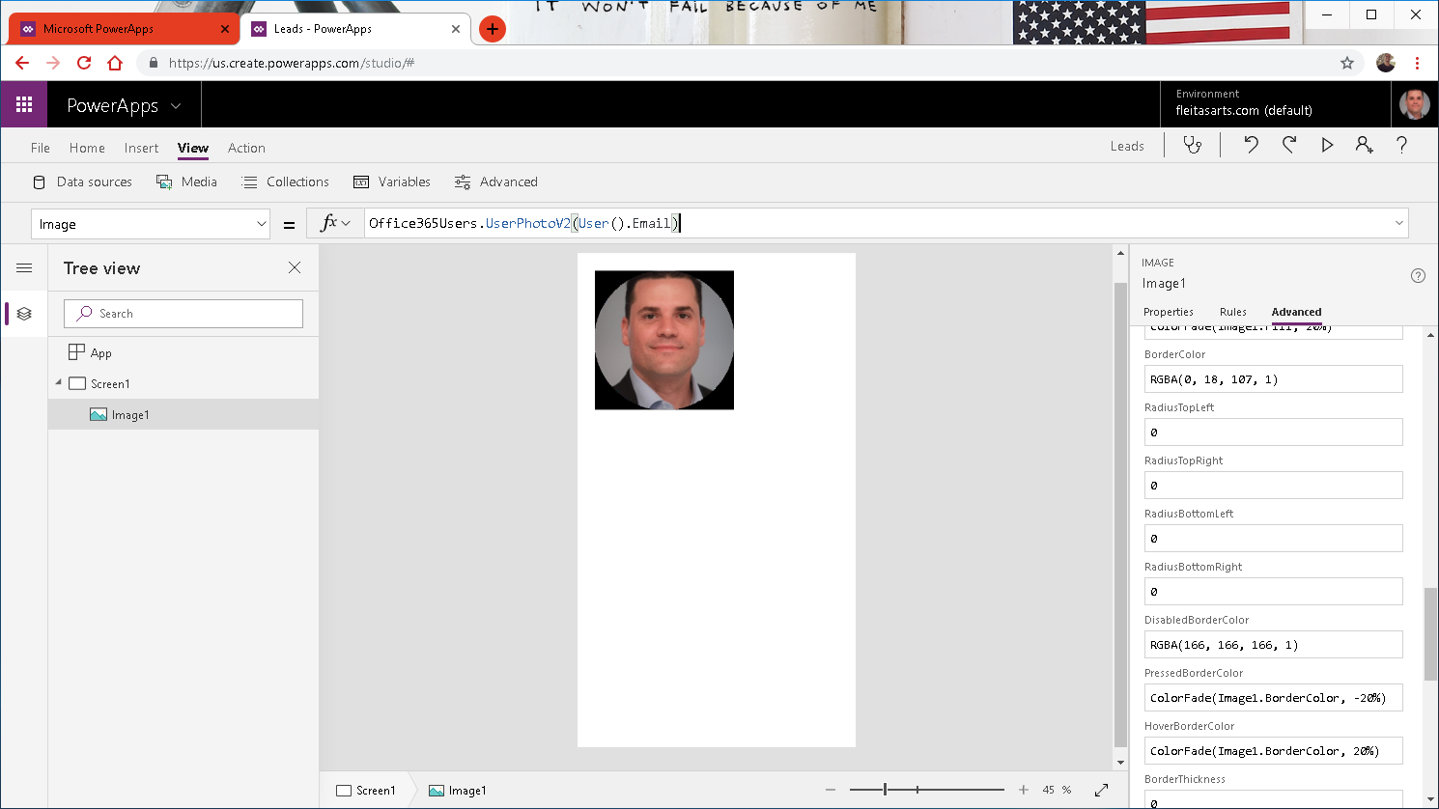

Slide 37
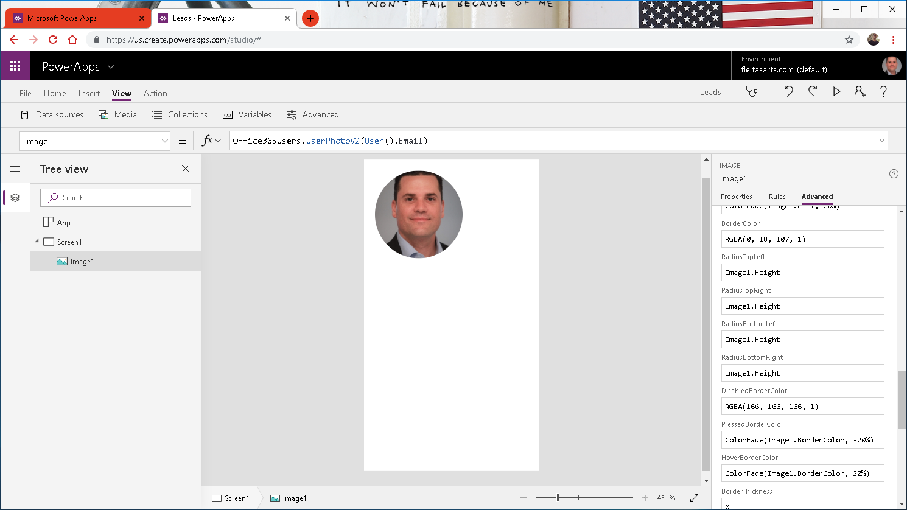

Slide 38
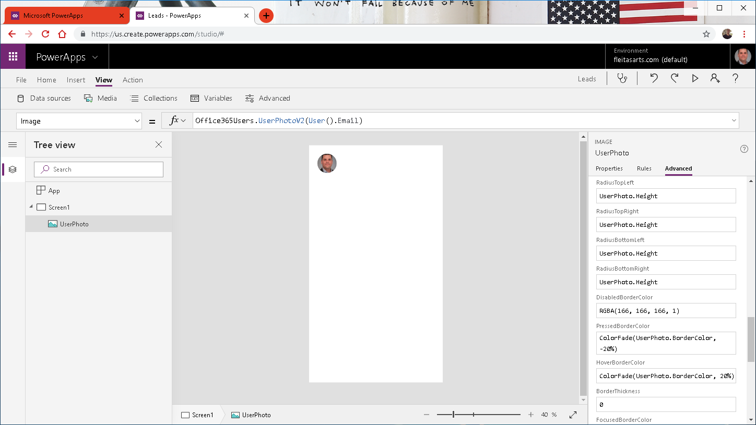

Slide 39
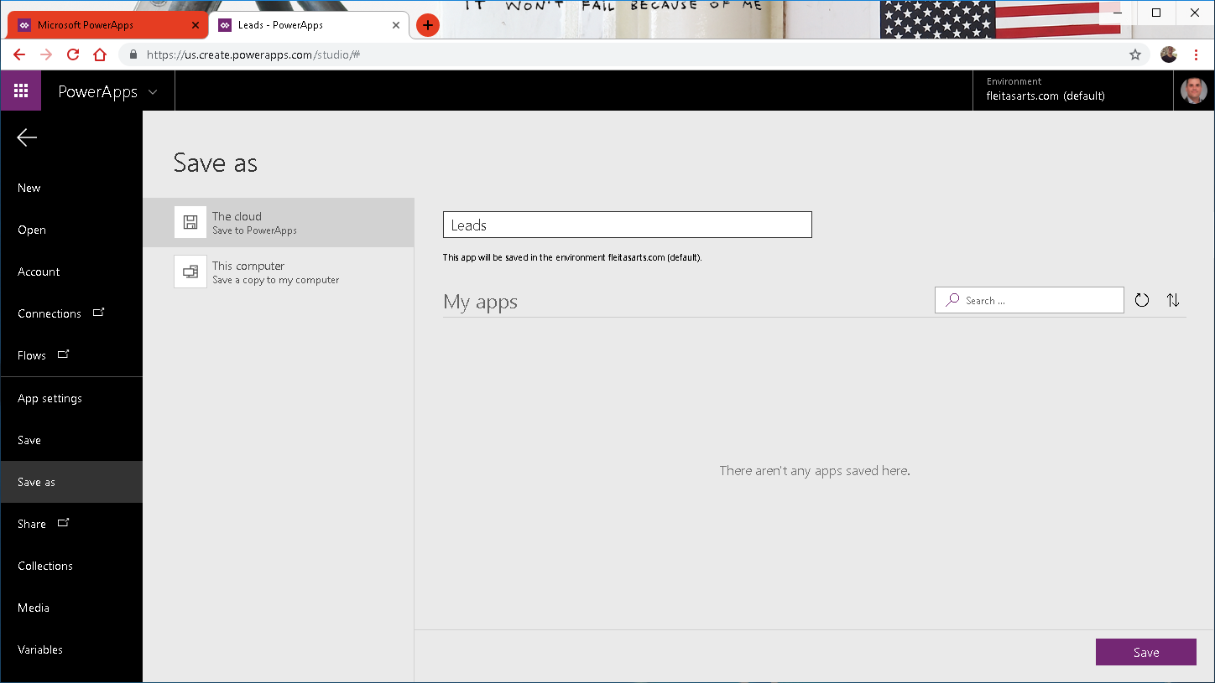


Slide 40
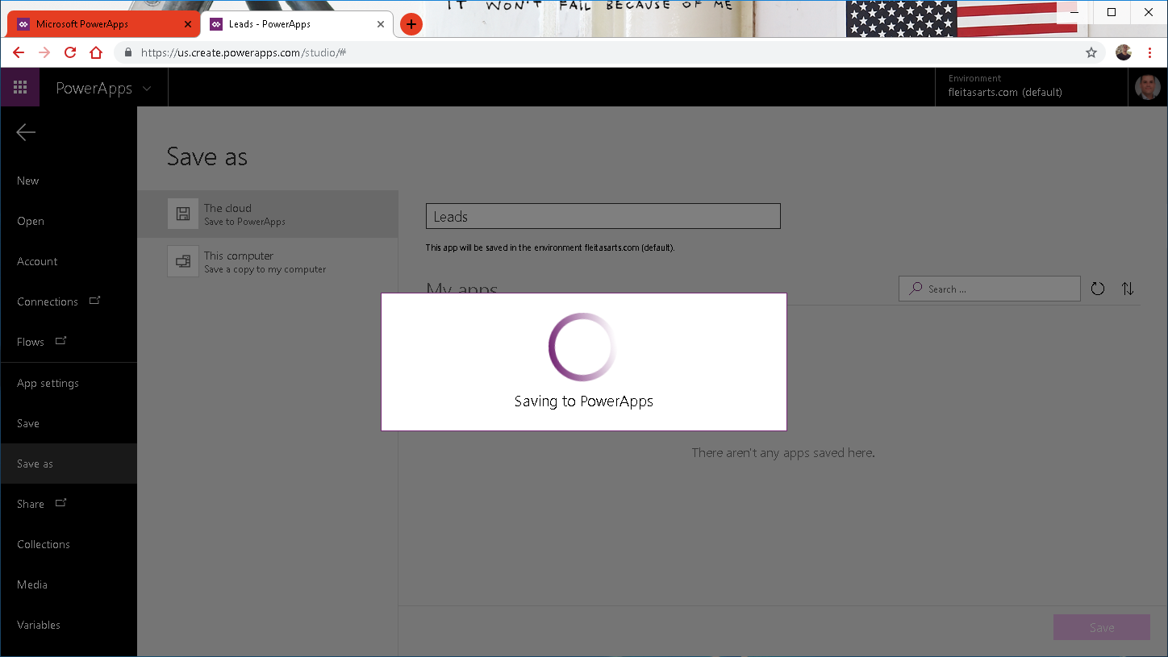

Slide 41
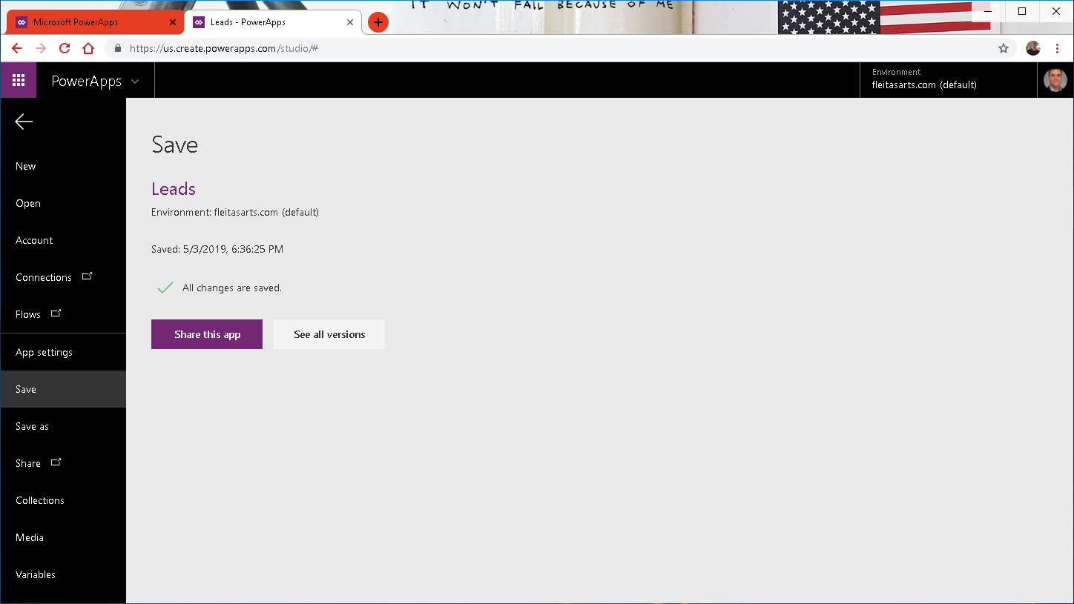

Slide 42
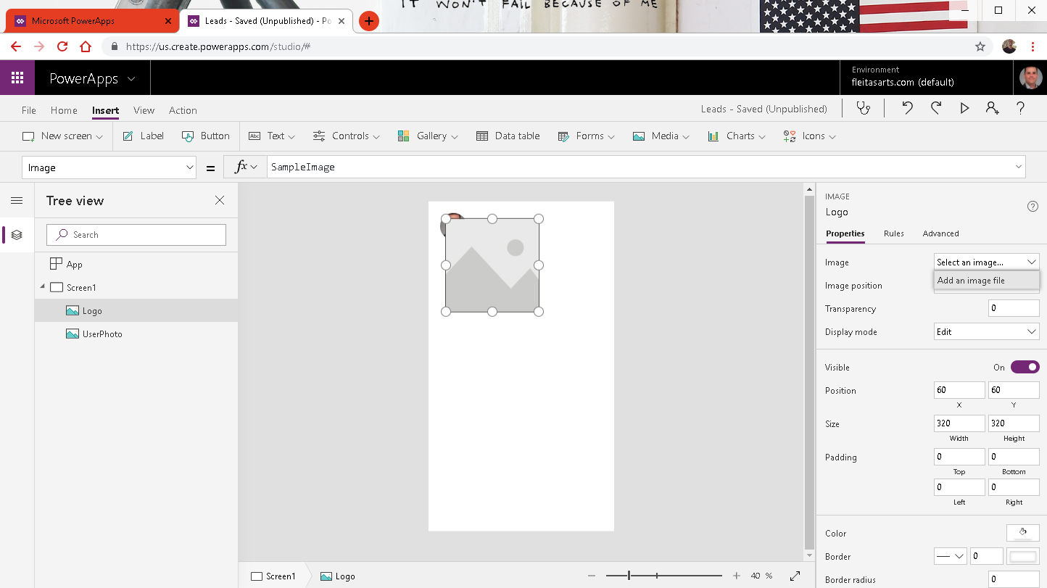
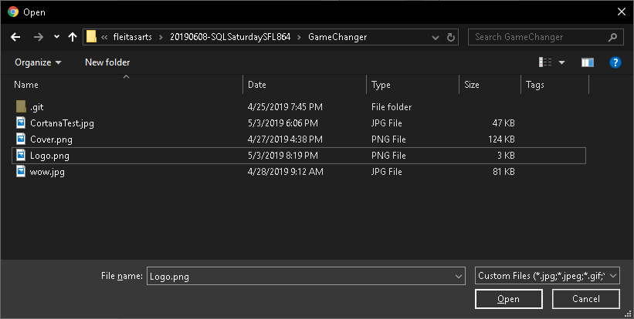

Slide 43
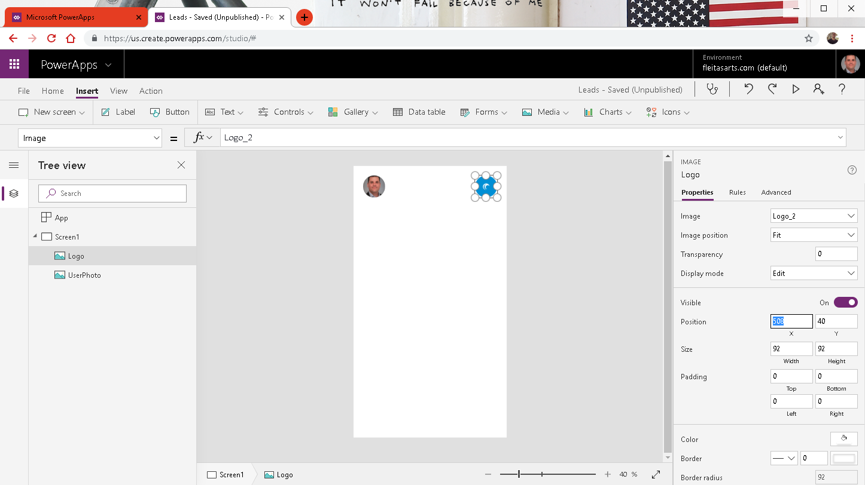

Slide 44
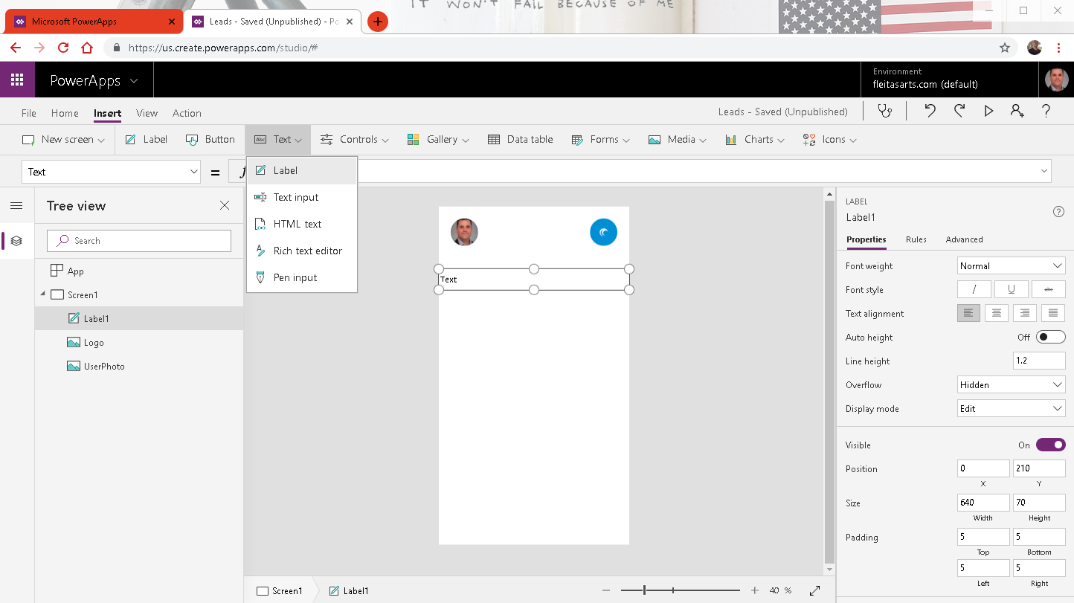
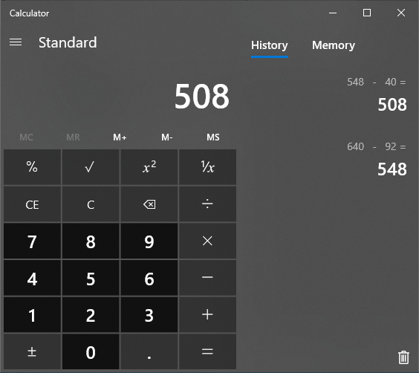

Slide 45
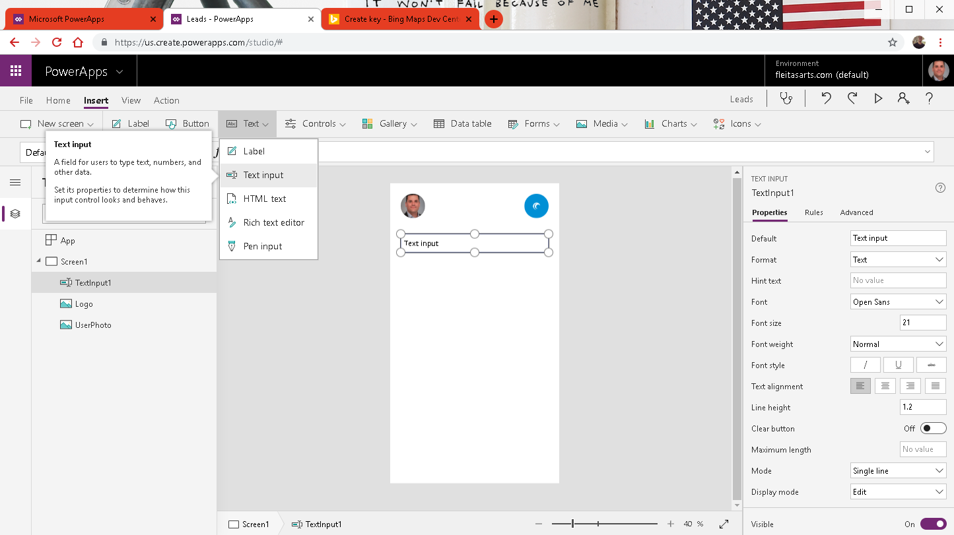

Slide 46
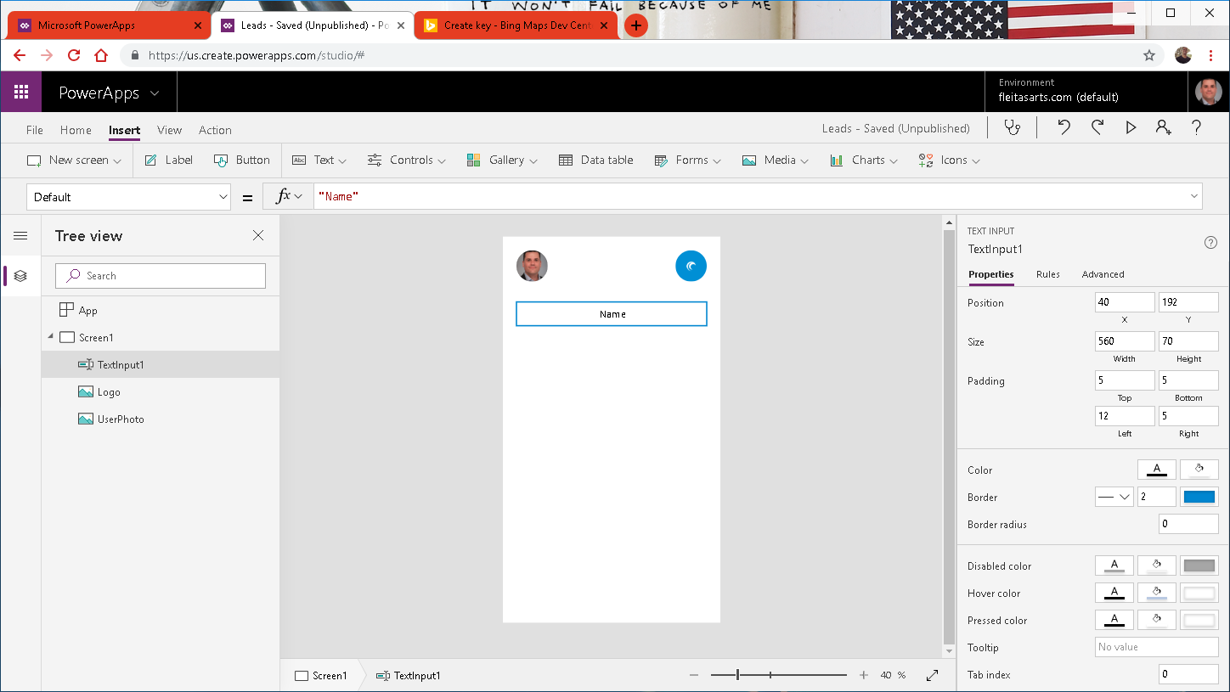
Notes:
Name, Email, Address

Slide 47


Slide 48
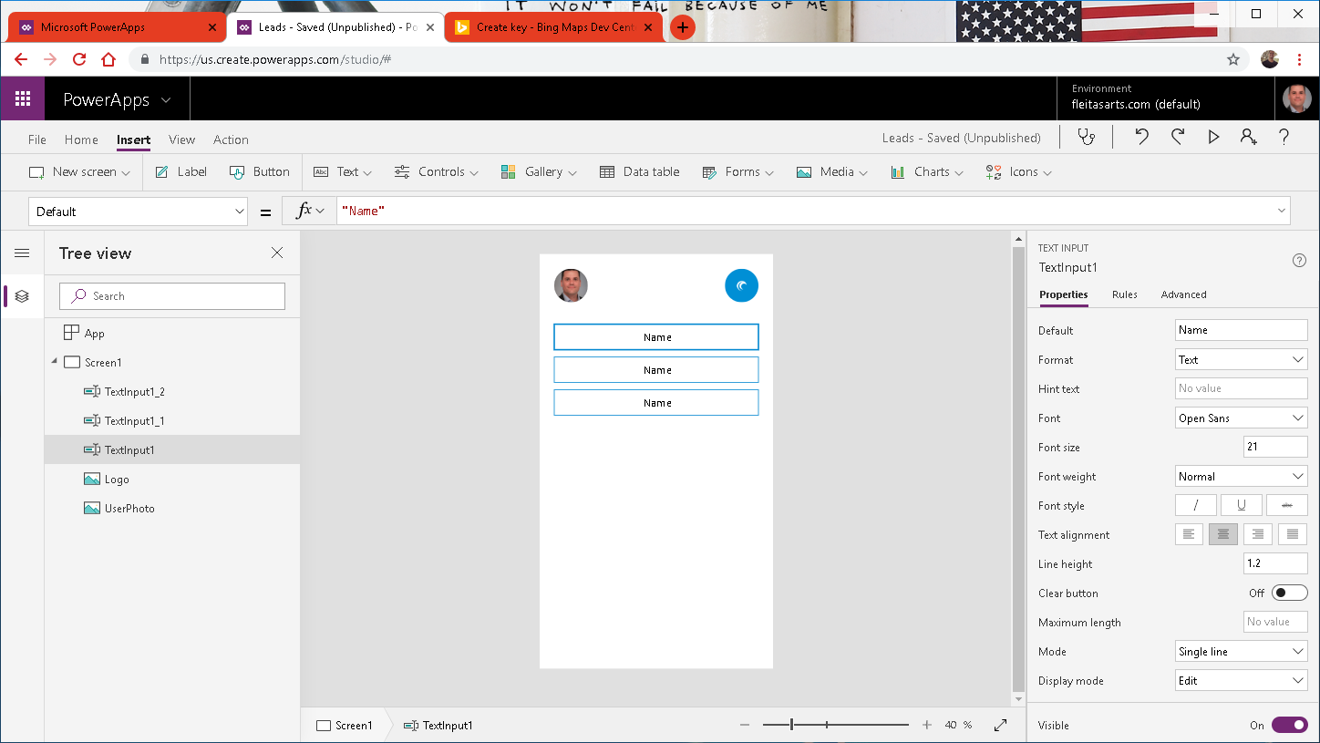

Slide 49
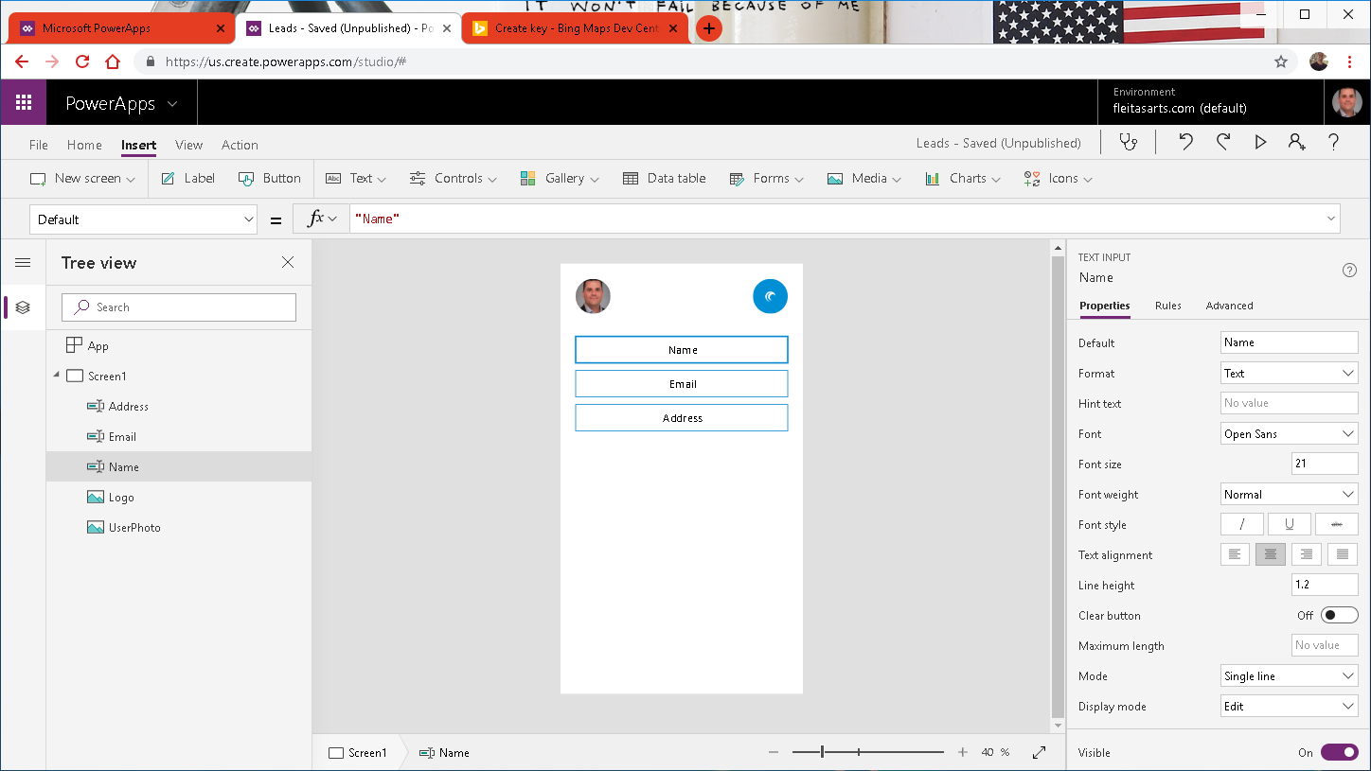

Slide 50
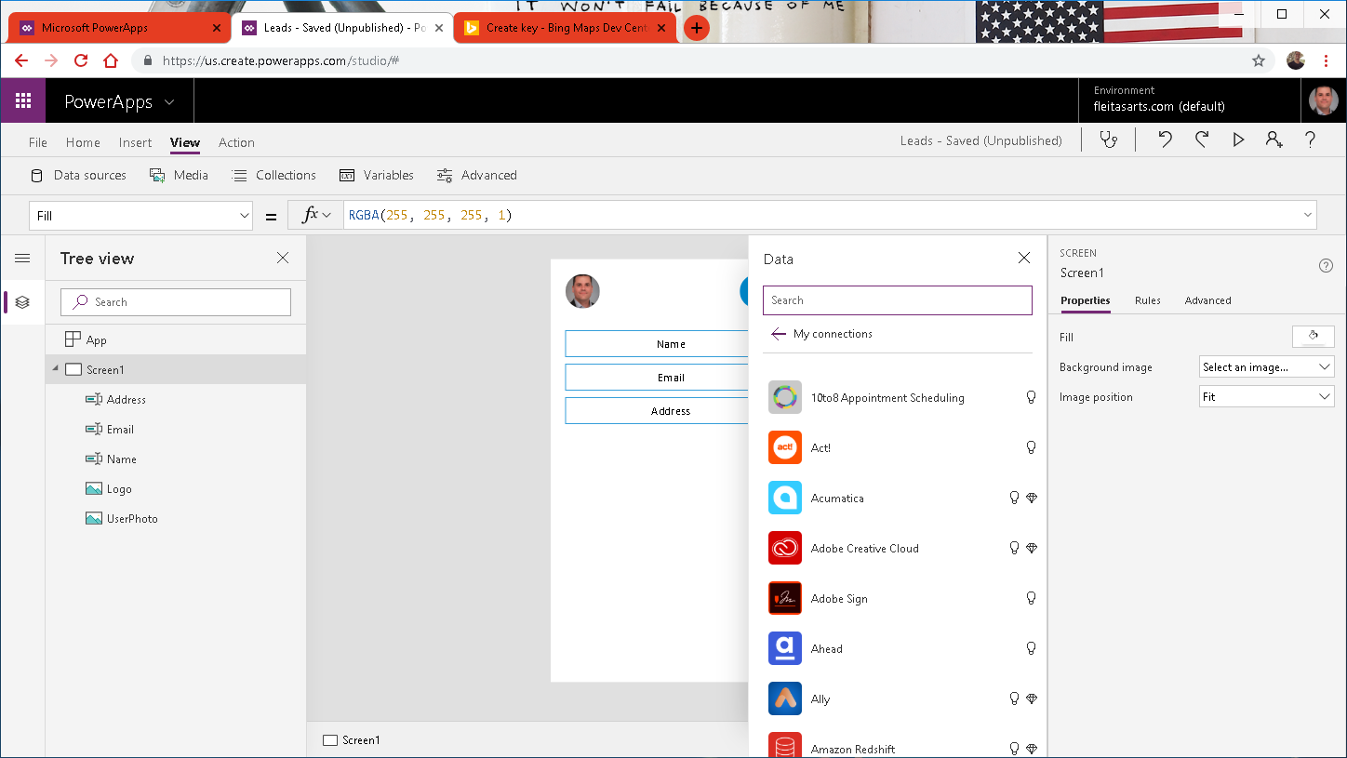

Slide 51
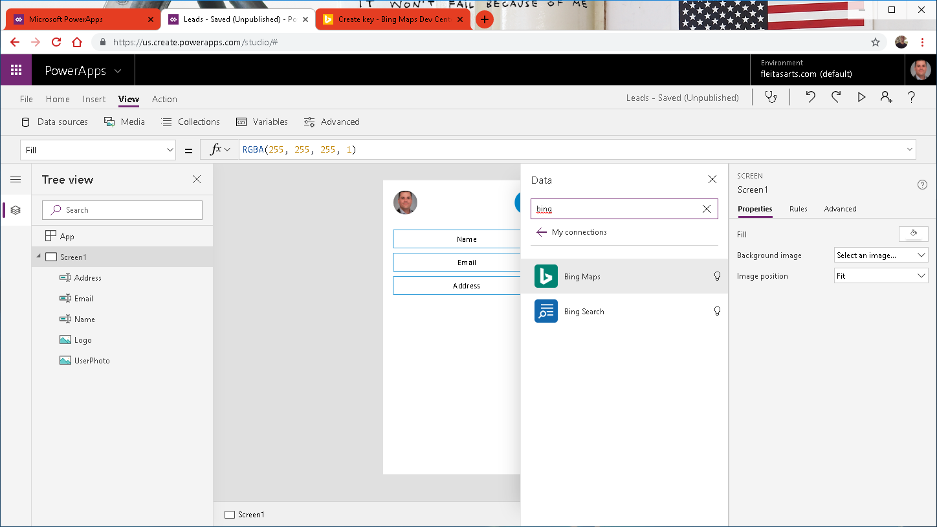
Notes:
Basic (50k/24hr, 125k/calendar yr)
Bing Maps can:
Create routes from A to B.
Give most efficient trucking routes.
Push pins on map locations.
Ref: https://docs.microsoft.com/en-us/bingmaps/getting-started/bing-maps-dev-center-help/getting-a-bing-maps-key

Slide 52
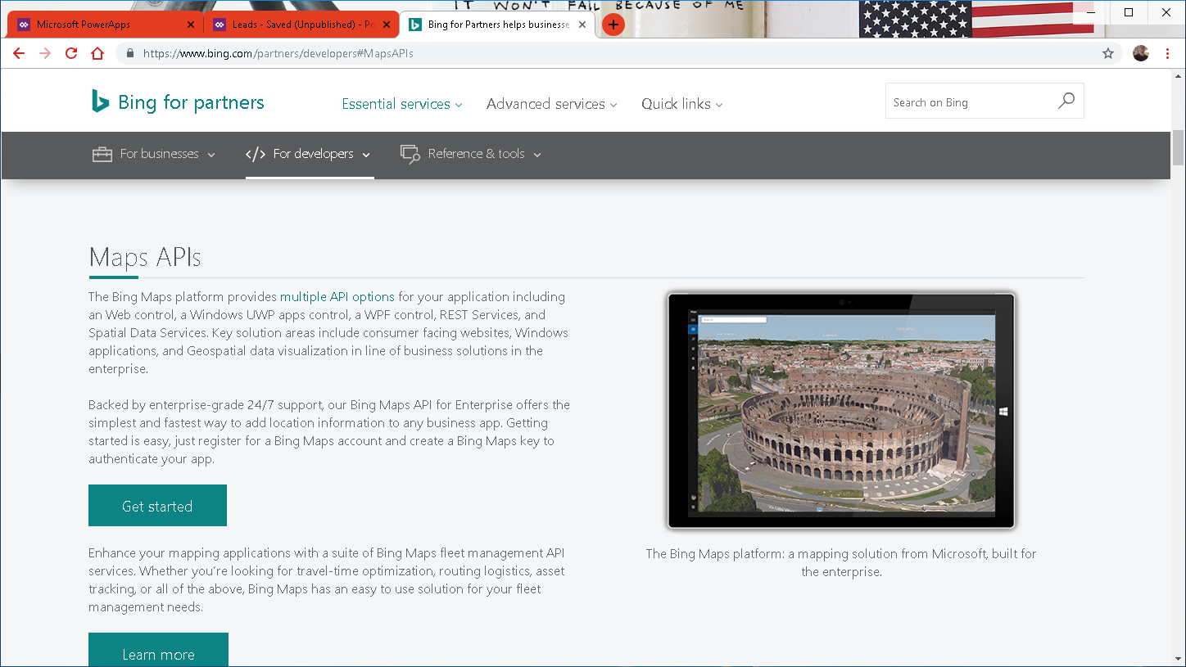
Notes:
Ref: https://docs.microsoft.com/en-us/bingmaps/getting-started/bing-maps-dev-center-help/getting-a-bing-maps-key

Slide 53
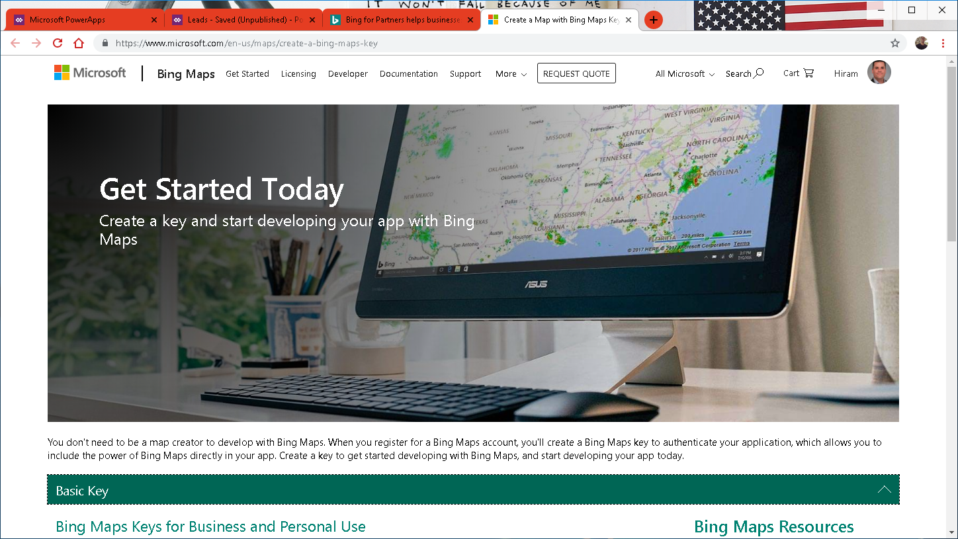
Notes:
Ref: https://docs.microsoft.com/en-us/bingmaps/getting-started/bing-maps-dev-center-help/getting-a-bing-maps-key

Slide 54
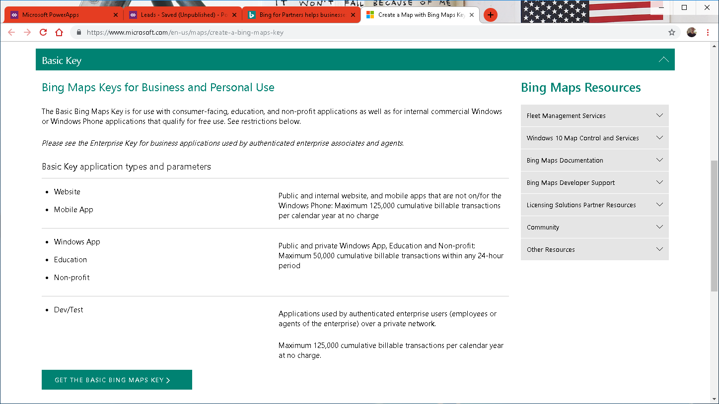
Notes:
Ref: https://docs.microsoft.com/en-us/bingmaps/getting-started/bing-maps-dev-center-help/getting-a-bing-maps-key

Slide 55
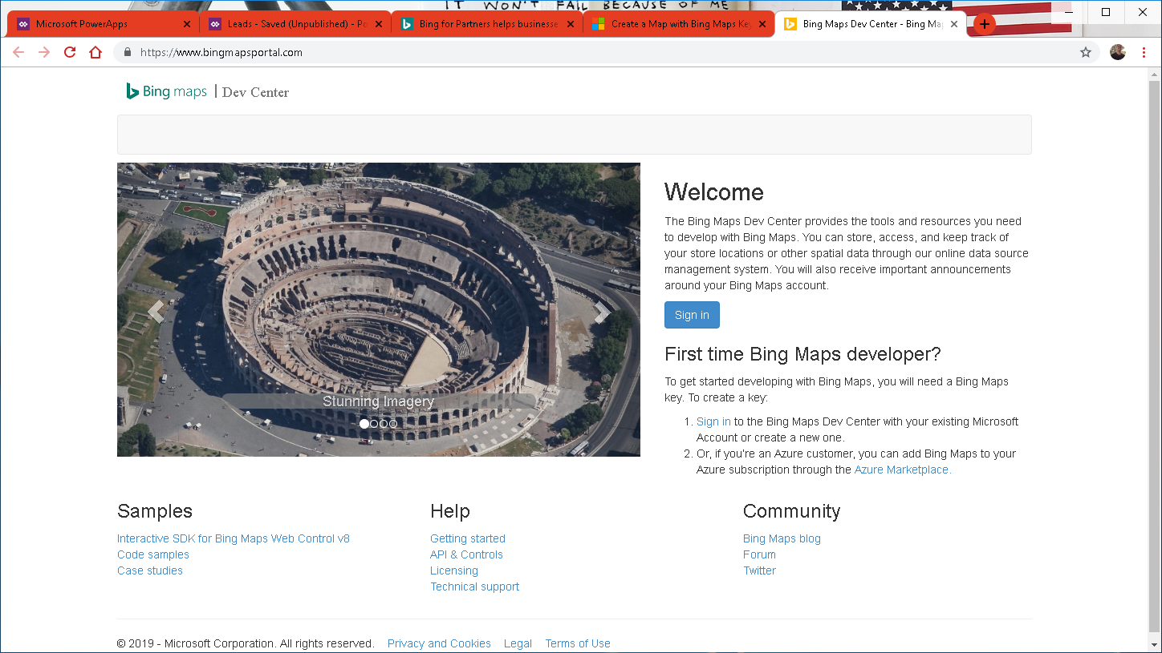
Notes:
Ref: https://docs.microsoft.com/en-us/bingmaps/getting-started/bing-maps-dev-center-help/getting-a-bing-maps-key

Slide 56

Notes:
Ref: https://docs.microsoft.com/en-us/bingmaps/getting-started/bing-maps-dev-center-help/getting-a-bing-maps-key

Slide 57

Notes:
Ref: https://docs.microsoft.com/en-us/bingmaps/getting-started/bing-maps-dev-center-help/getting-a-bing-maps-key

Slide 58

Notes:
Ref: https://docs.microsoft.com/en-us/bingmaps/getting-started/bing-maps-dev-center-help/getting-a-bing-maps-key

Slide 59

Notes:
Ref: https://docs.microsoft.com/en-us/bingmaps/getting-started/bing-maps-dev-center-help/getting-a-bing-maps-key

Slide 60

Notes:
Ref: https://docs.microsoft.com/en-us/bingmaps/getting-started/bing-maps-dev-center-help/getting-a-bing-maps-key

Slide 61

Notes:
Ref: https://docs.microsoft.com/en-us/bingmaps/getting-started/bing-maps-dev-center-help/getting-a-bing-maps-key

Slide 62

Notes:
Ref: https://docs.microsoft.com/en-us/bingmaps/getting-started/bing-maps-dev-center-help/getting-a-bing-maps-key

Slide 63

Notes:
Ref: https://docs.microsoft.com/en-us/bingmaps/getting-started/bing-maps-dev-center-help/getting-a-bing-maps-key

Slide 64

Notes:
Basic (50k/24hr, 125k/calendar yr)
Bing Maps can:
Create routes from A to B.
Give most efficient trucking routes.
Pushpins on map locations.
Ref: https://docs.microsoft.com/en-us/bingmaps/getting-started/bing-maps-dev-center-help/getting-a-bing-maps-key

Slide 65


Slide 66


Slide 67


Slide 68


Slide 69

Notes:
Ref: Integrating Bing Maps into PowerApps and Using the GPS: https://youtu.be/swpjfIyXCNA
Ref: https://docs.microsoft.com/en-us/bingmaps/rest-services/locations/find-a-location-by-address

Slide 70


Slide 71


Slide 72

Evaluate
Then true
Else false
Notes:
Pushpin: https://docs.microsoft.com/en-us/bingmaps/rest-services/common-parameters-and-types/pushpin-syntax-and-icon-styles

Slide 73

Notes:
Ref: Pushpin: https://docs.microsoft.com/en-us/bingmaps/rest-services/common-parameters-and-types/pushpin-syntax-and-icon-styles

Slide 74

Notes:
3 buttons

Slide 75


Slide 76

Notes:
Ref: Launch: https://docs.microsoft.com/en-us/powerapps/maker/canvas-apps/functions/function-param

Slide 77

Notes:
Ref: Launch: https://docs.microsoft.com/en-us/powerapps/maker/canvas-apps/functions/function-param

Slide 78


Slide 79


Slide 80


Slide 81

Notes:
Color RGBA(255,255,255,1)

Slide 82

Notes:
Fill Visual Background Color RGBA(0,0,0,0)

Slide 83


Slide 85


Slide 86


Slide 87


Slide 88

Notes:
Ref: https://uifabricicons.azurewebsites.net/

Slide 89


Slide 90


Slide 92


Slide 93


Slide 94

Notes:
Border: None
Color:

Slide 95


Slide 96


Slide 97


Slide 98


Slide 99

Notes:
I check for Email because it’s more unique vs Name or Address.

Slide 100

Notes:
The delete event could be for multiple addresses so the combination of 2 identifiers such as Name and Email get us there.

Slide 101


Slide 102

Notes:
Need to create 4 Flows:
LinkLead
DeleteLead
CheckLead
AddLead

Slide 103
Power Automate
three

Slide 104

Notes:
https://flow.microsoft.com

Slide 105



Slide 106


Slide 107


Slide 108


Slide 109

Notes:
Click Ask in PowerApps

Slide 110


Slide 111


Slide 112

body('Execute_stored_procedure')?['resultsets']
Notes:
body('Execute_stored_procedure')?['resultsets']

Slide 113

body('Execute_stored_procedure_(V2)')?['resultsets']
Notes:
body('Execute_stored_procedure')?['resultsets']

Slide 114


Slide 115


Slide 116


Slide 117


Slide 118



Slide 119


Slide 121


Slide 122


Slide 123


Slide 124


Slide 125


Slide 126


Slide 127


Slide 128


Slide 129


Slide 130


Slide 131


Slide 132


Slide 133


Slide 134


Slide 135


Slide 136

Notes:
Ref:https://flow.microsoft.com/en-us/blog/announcing-microsoft-flow-analytics/
Roadmap:
https://powerapps.microsoft.com/en-us/roadmap/
https://us.flow.microsoft.com/en-us/roadmap/
https://powerbi.microsoft.com/en-us/roadmap/

Slide 137
Data Gateway
four

Slide 138


Slide 139



Slide 141





Slide 142




Slide 143


Slide 145



Slide 147


Slide 148


Slide 149


Slide 150

Notes:
Install Gateway, at this point the Windows ACU prompt.

Slide 151

Notes:
Install Gateway, at this point the Windows ACU prompt again.

Slide 152


Slide 153


Slide 154

Notes:
THIS IS VERY IMPORTANT!!!!

Slide 155

Notes:
At this point the Gateway is installed and running.
See Service Settings, Diagnostics, Network and Connectors for more info.

Slide 156

Notes:
At this point the Gateway is installed and running.
See Service Settings, Diagnostics, Network and Connectors for more info.

Slide 157

Notes:
At this point the Gateway is installed and running.
See Service Settings, Diagnostics, Network and Connectors for more info.

Slide 158


Notes:
At this point the Gateway is installed and running.
See Service Settings, Diagnostics, Network and Connectors for more info.

Slide 159

Notes:
At this point the Gateway is installed and running.
See Service Settings, Diagnostics, Network and Connectors for more info.

Slide 160
Siri
five

Slide 161



Slide 162



Slide 163
six
Publish & Share Security Governance

Slide 164


Slide 165


Slide 166


Slide 167


Slide 168


Slide 169


Slide 170


Slide 171


Slide 172


Slide 173



Slide 174



Slide 175



Slide 176



Slide 177



Slide 178



Slide 179



Slide 180



Slide 181



Slide 182




Slide 183



Slide 184


Slide 185



Slide 187


Slide 188


Slide 189


Slide 190


Slide 191


Slide 192


Slide 193


Slide 194


Slide 195


Slide 196


Slide 197


Slide 198


Slide 199


Slide 200


Slide 201


Slide 202


Slide 203


Slide 204


Slide 205


Slide 206


Slide 207


Slide 208


Slide 209

Notes:
Microsoft Intune is a cloud-based service in the enterprise mobility management (EMM) space that helps enable your workforce to be productive while keeping your corporate data protected.
https://docs.microsoft.com/en-us/intune/what-is-intune

Slide 210


End

Slide 211
Summary
Azure Data Studio Notebook
PowerApps
Microsoft Flow
Data Gateway
Siri
Publish & Share – Security

Slide 212
Resources
fleitasarts.com
github.com/hfleitas/seattle2019
Microsoft Learn
Pricing
Integrating Bing Maps with GPS
Scrolling Screen
Display User Profile Photo
Notes:
https://dba2o.wordpress.com/
https://docs.microsoft.com/learn/browse/?products=power-platform
https://docs.microsoft.com/power-platform/admin/pricing-billing-skus
https://youtu.be/swpjfIyXCNA
https://docs.microsoft.com/powerapps/maker/canvas-apps/add-scrolling-screen
https://youtu.be/rcrubFa8758
https://youtu.be/SaDEVOgOlYY
https://powerusers.microsoft.com/t5/General-Discussion/image-in-a-circle/m-p/9124#M4007
https://docs.microsoft.com/power-bi/service-cortana-intro
https://docs.microsoft.com/powerapps/maker/canvas-apps/open-and-run-a-sample-app
https://docs.microsoft.com/powerapps/maker/canvas-apps/webinars-listing
https://go.microsoft.com/fwlink/?LinkId=2005303&clcid=0x409
https://www.microsoft.com/en-us/businessapplicationssummit

Slide 213
Resources
Modal (Pop-up) Screen
Image Circle Crop
Siri Shortcuts
Sample canvas apps (Expense Report, Help Desk, Meeting Capture)
Webinar Listing
ROI Case Study

Slide 214

Community
Power BI
PowerApps
Microsoft Flow
Data Stories Gallery
Discuss, Connect, Feedback
Notes:
https://powerusers.microsoft.com/
Data Stories Gallery
Discuss, Connect, Feedback

Slide 215
Link to Eval:
bit.ly/pbifest19
Your participation is very important.

Slide 216

Hiram Fleitas
Owner
Fleitas Arts
Thank You
@hiramfleitas
hiram@fleitasarts.com
fleitasarts.com
/hfleitas
hiramfleitas

